Slide 1
Studying Silk Road networks through Roman artefacts in China
Krisztina Hoppál
可茉
ELTE Roman World and the Far East Research Group
Eötvös Loránd University, Hungary

Slide 2
Content
I. Strengths & Limits of Research
II. Analytical Framework
III. Materials & Distributions
IV. Observations
V. Conclusion

Slide 3
I. Strengths & Limits of Research
Limits:
No proper context for many materials due to old or uncontrolled excavations (SEA)
Archaeological traditions with different agendas and excavation focus
Texts only generated from the West and China

Slide 4
I. Strengths & Limits of Research
Strengths
Shift from the Western-centered paradigm
Using texts and regional databases
Using new analythical methods
New and re-evaluated archaeological data
Integration of less-recognized regions
Using theoretical models
(human-thing entanglement; reception theory)

Slide 5
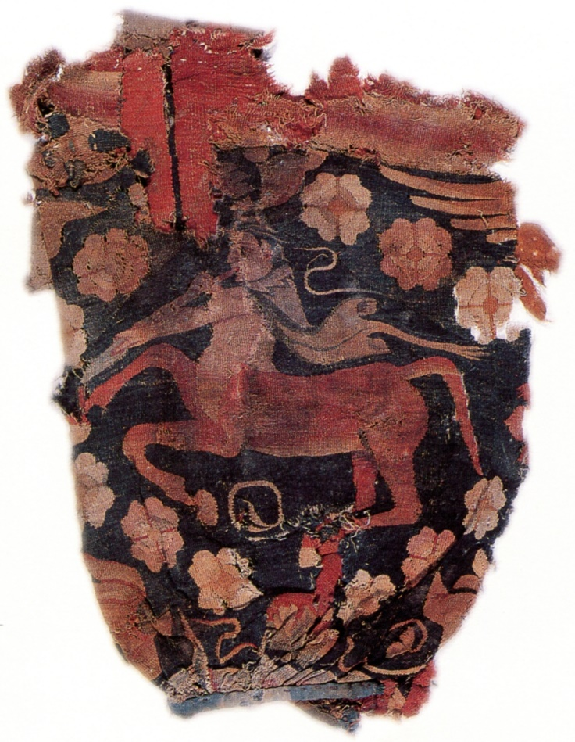
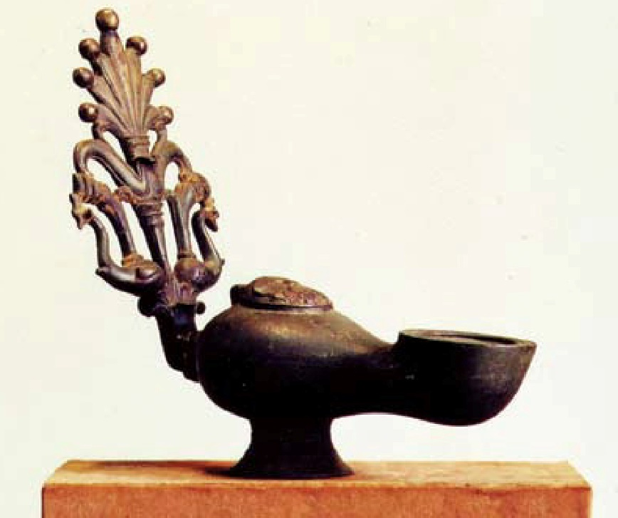
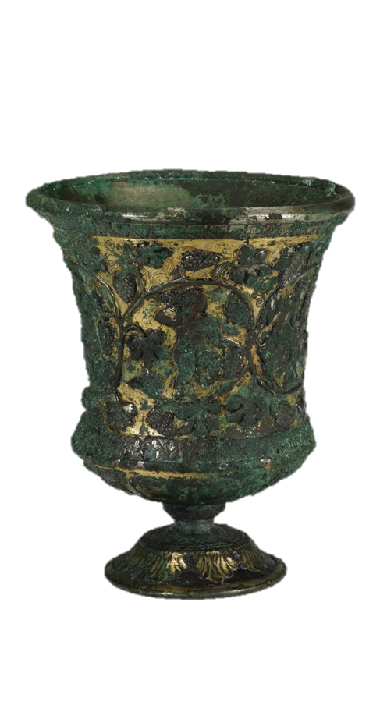
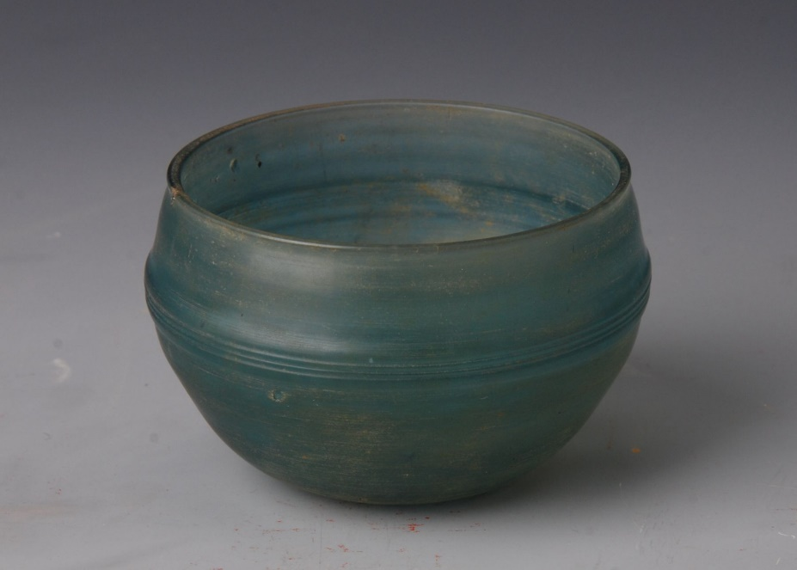
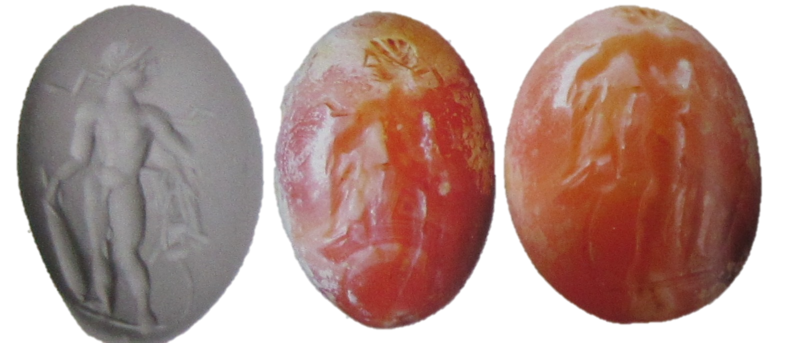
I. Strengths & Limits of Research
Roman?
Borell 2008,17.
新疆维吾尔自治区博物馆–新疆文物考古研究所 2001.
©Natski&Aminda
www.sxcr.gov.cn
©廣西壯族自治區博物館
Borell 2017,62.

Slide 6
II. Analytical Framework
Techno-stylistic analysis:
Interpret and discuss Asia-discovered materials in terms of levels of interactions
Roman style objects in local contexts
Objects of Mediterranean origin
Integrating Roman/Hellenistic visual elements to varying degrees
Mediterranean raw materials
K. Hoppál, B. Bellina, L. Dussubieux, “Links between the Mediterranean world, South Asia, Southeast Asia and China from the late first millennium BC to the early first centuries AD” In: M. Nenna et al. (eds.) Proceedings of Alexandria the cosmopolis: a global perspective, Centre d'études alexandrines, December 2-5, 2019, Alexandria, EGYPT, ÉTUDES ALEXANDRINES (in press)

Slide 7
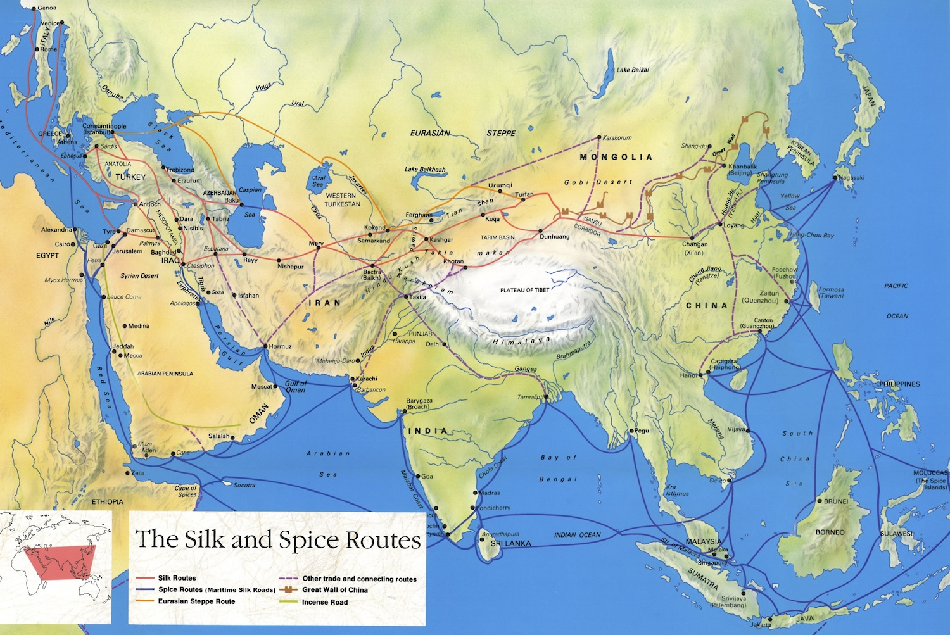
III. Materials & Distributions

Slide 8
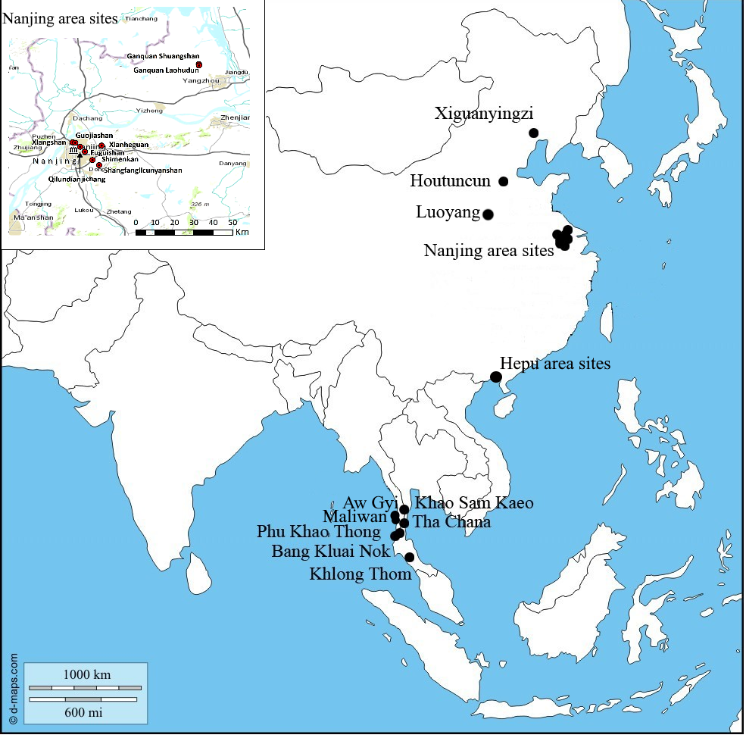
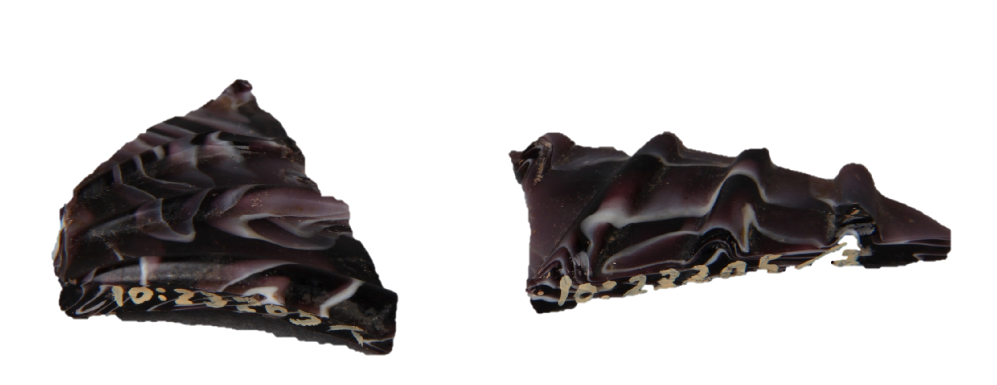
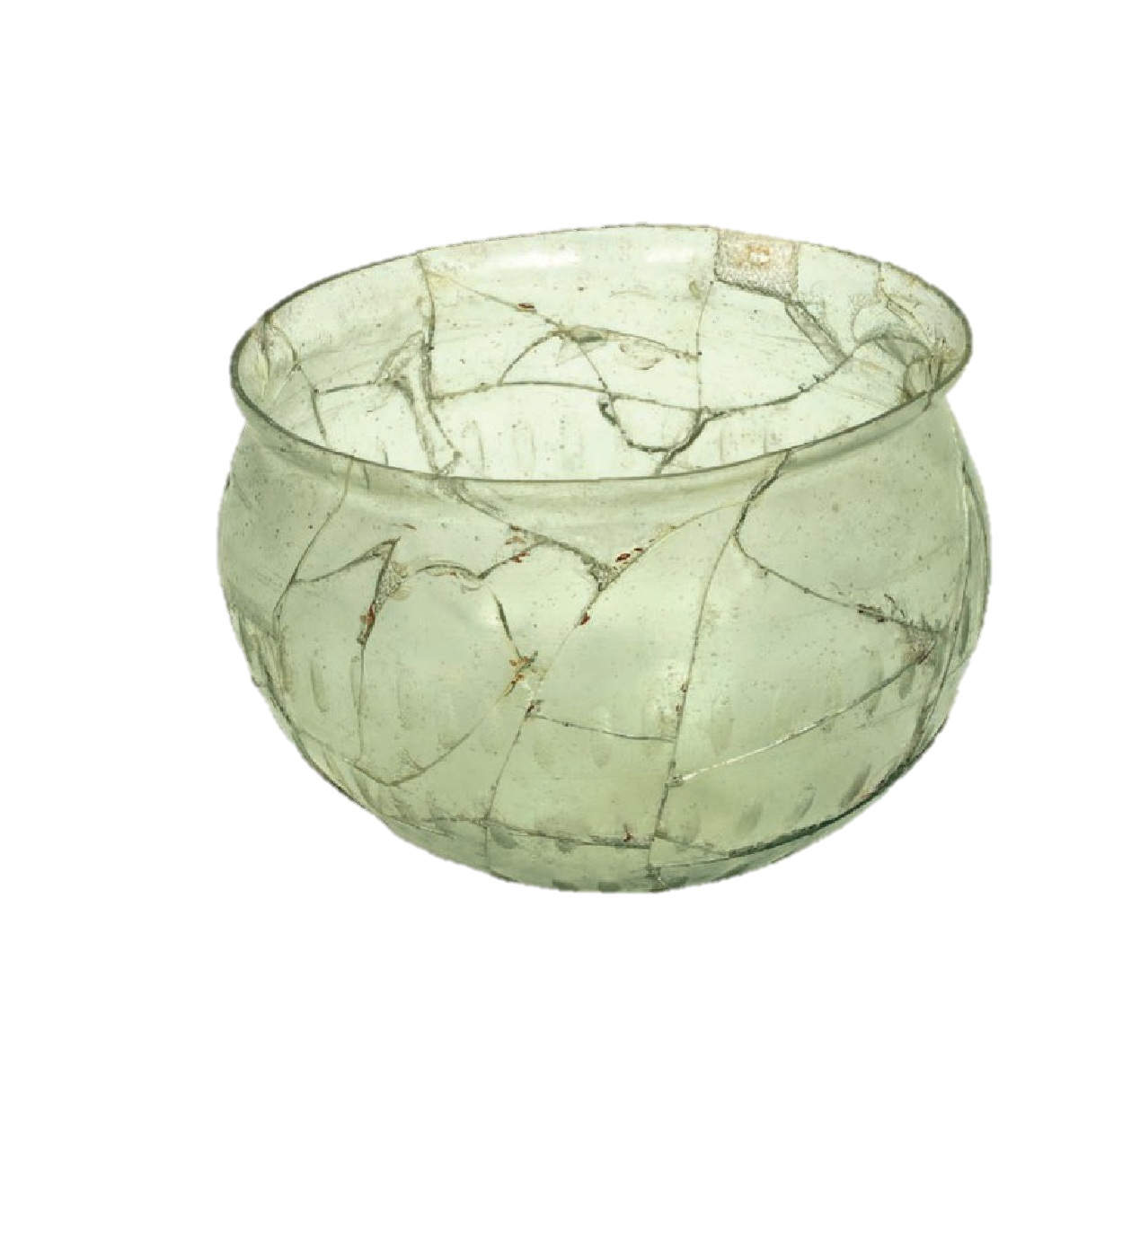
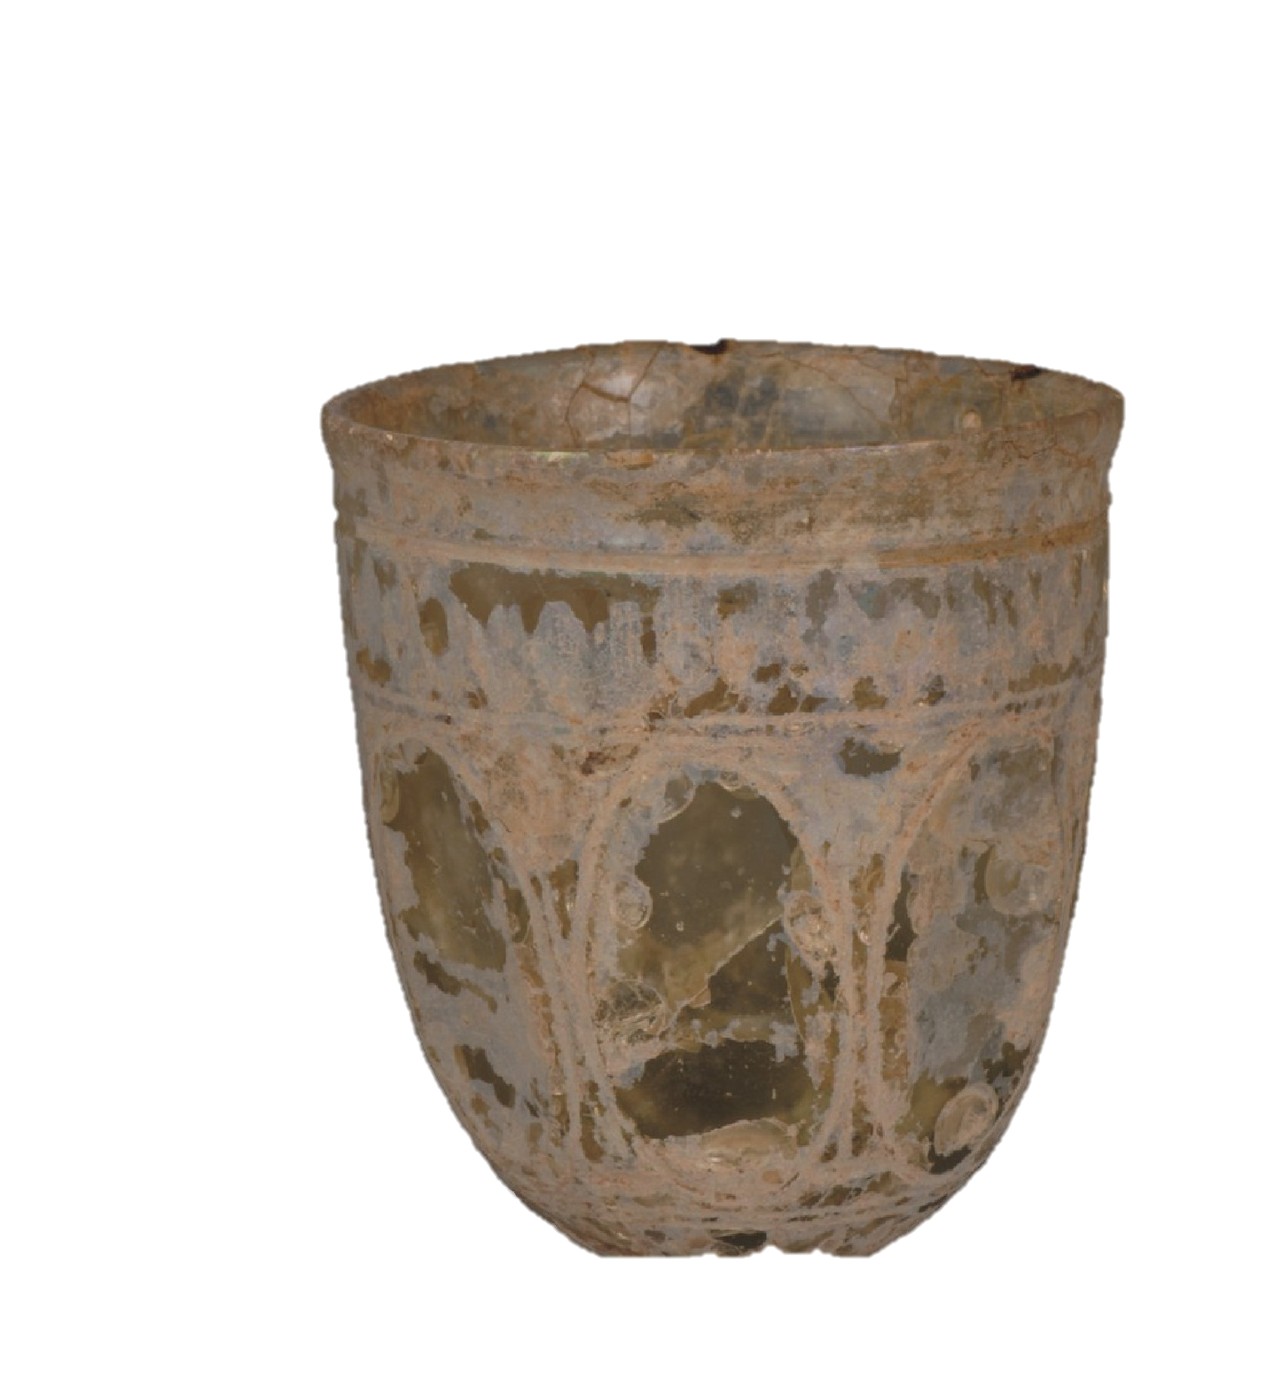
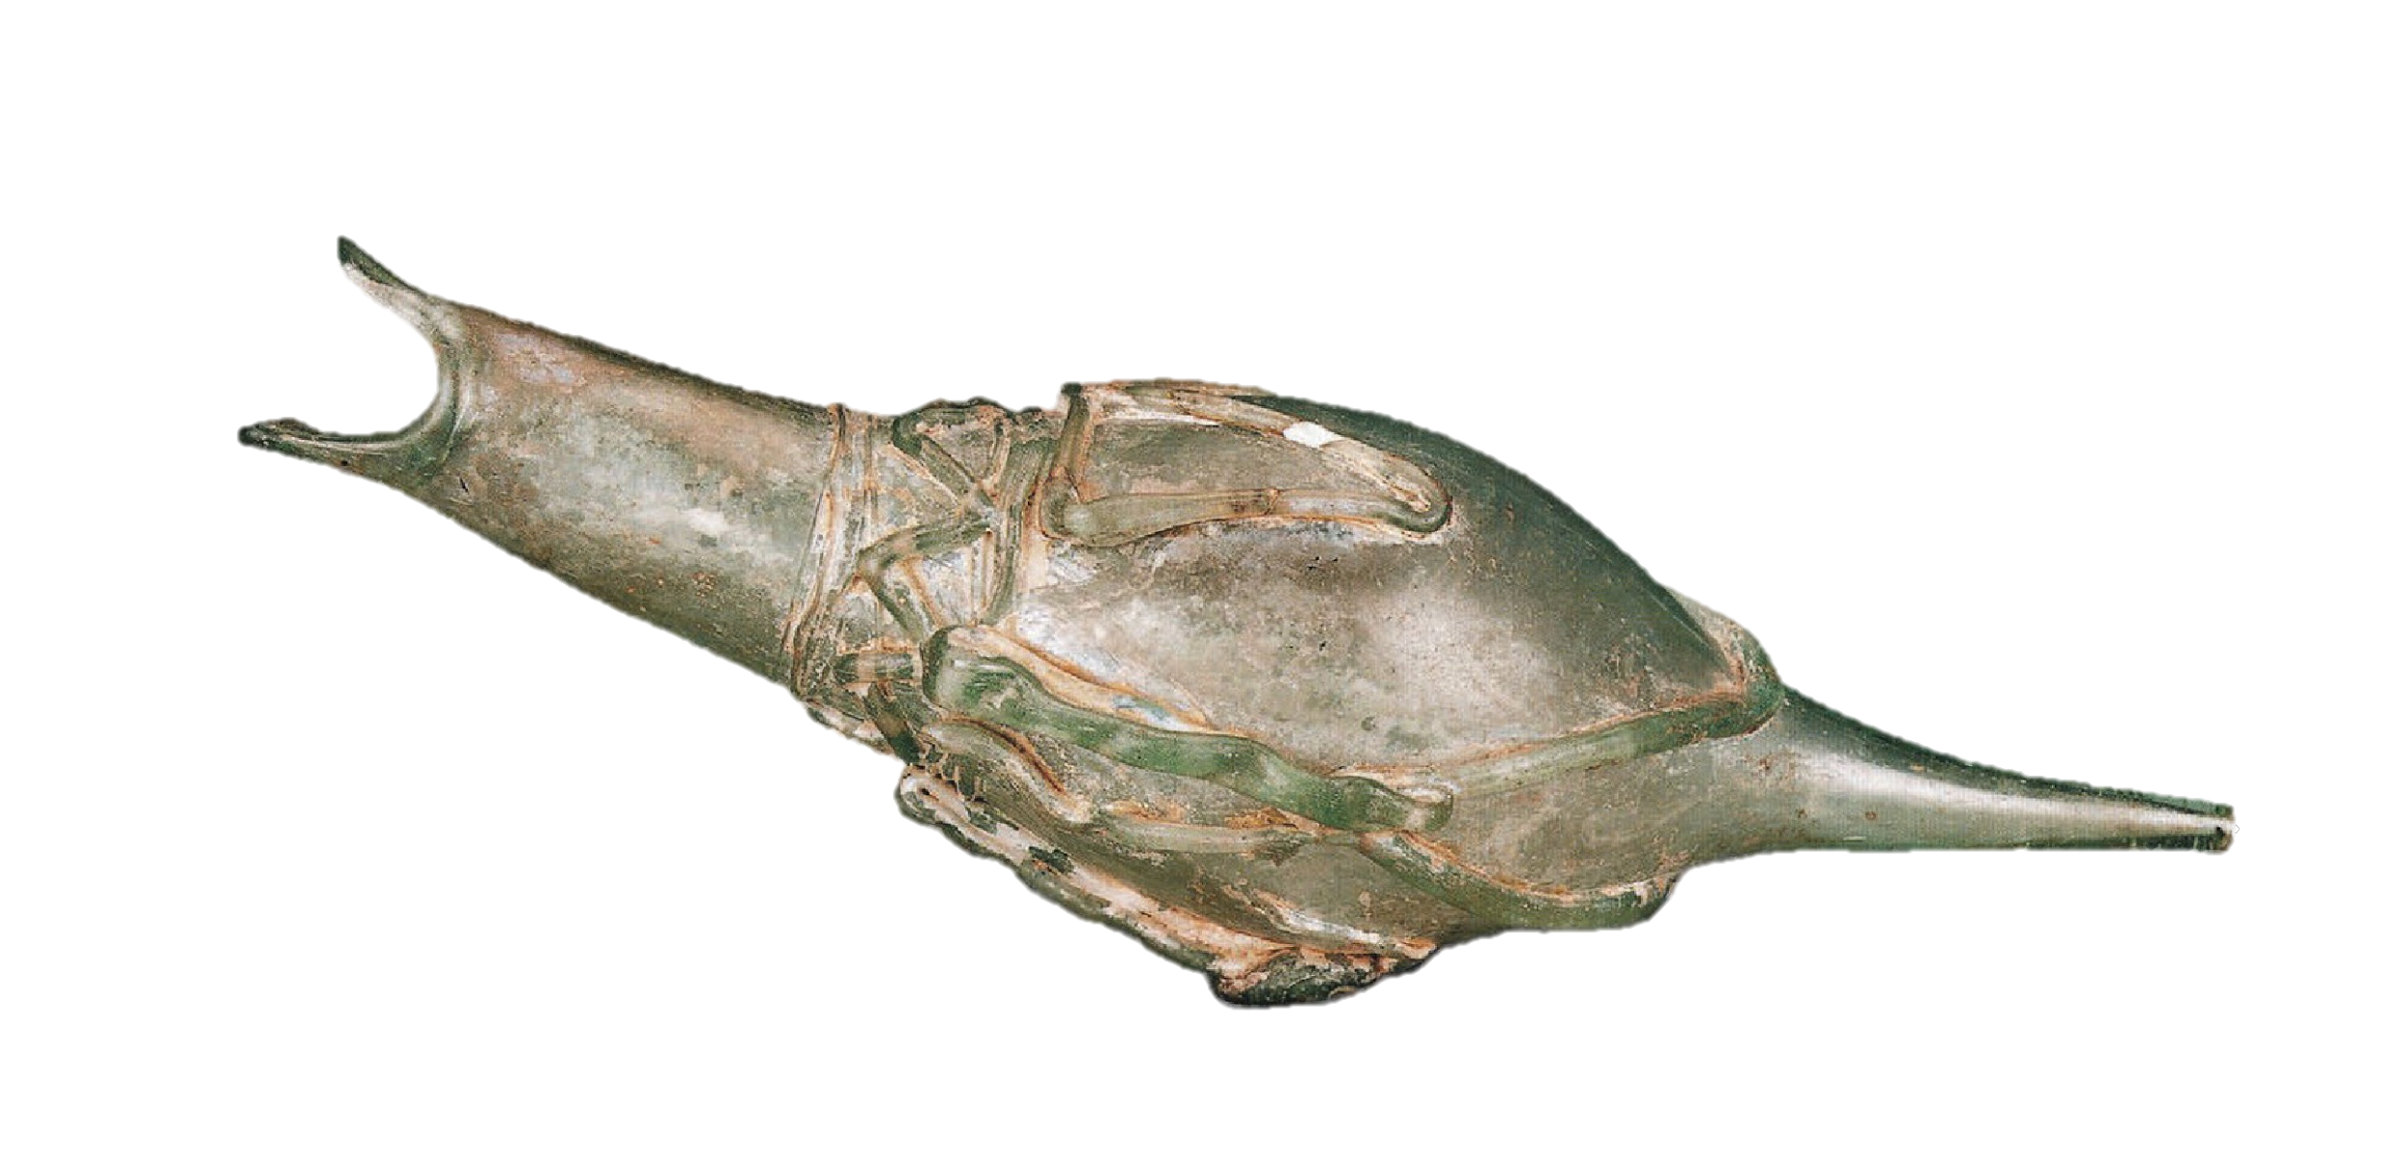
Eastern China
© Nanjing Bowuyuan
Nanjingshi Bowuguan 2004.
Gan 2009

Slide 9
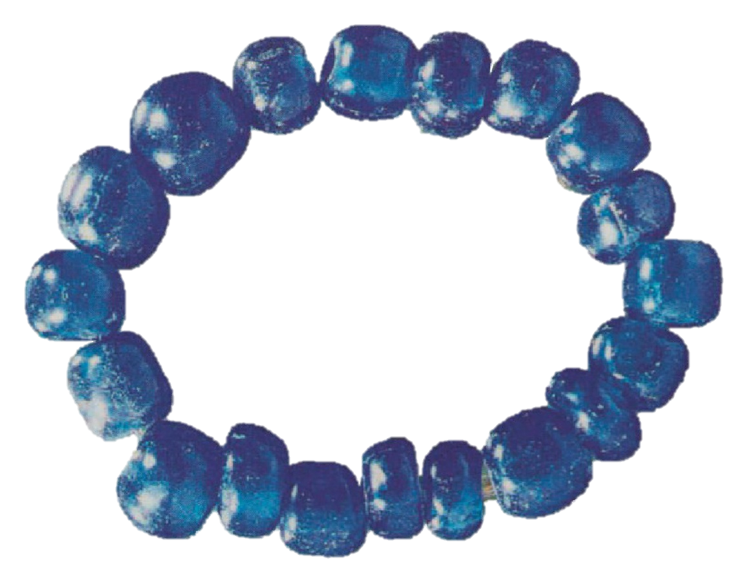
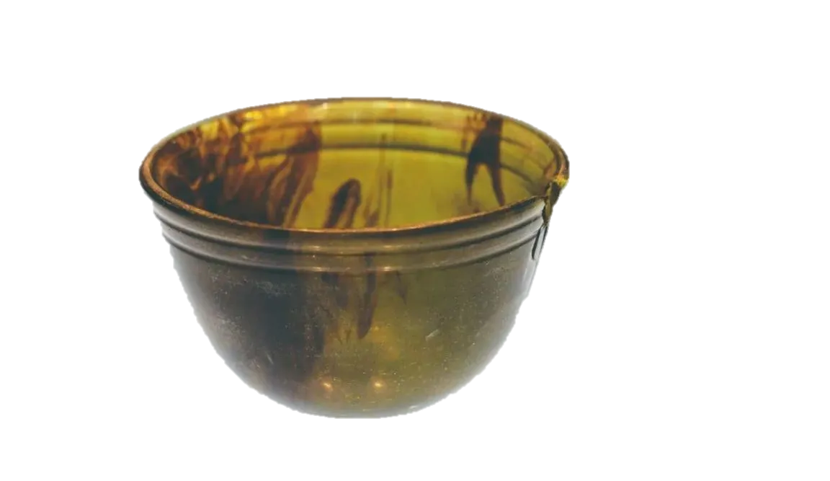
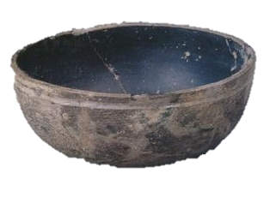
Southern China
Xiong 2014.
Xiong 2022.
©National Museum of China

Slide 10
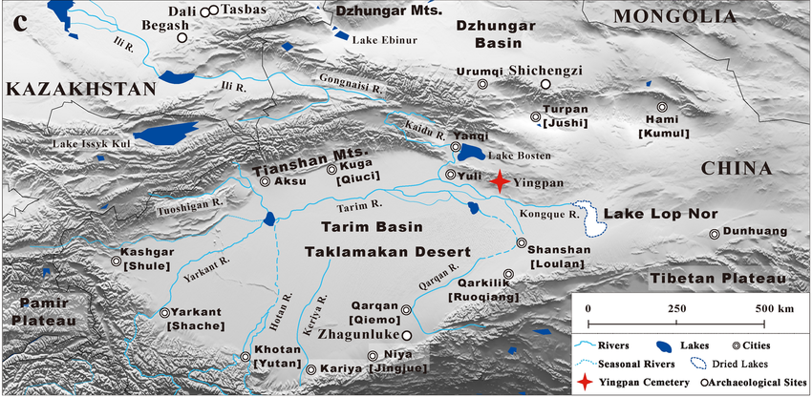
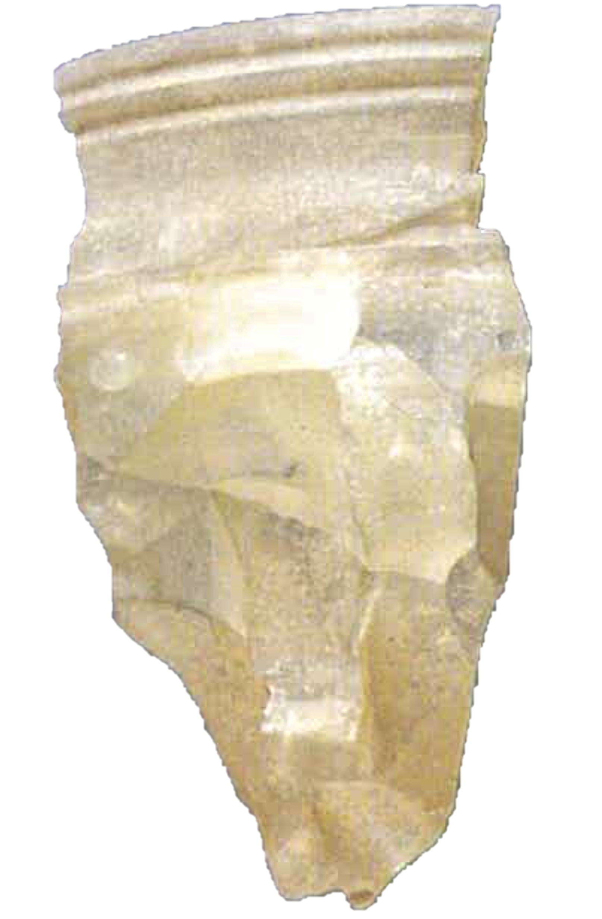
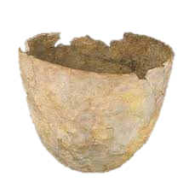
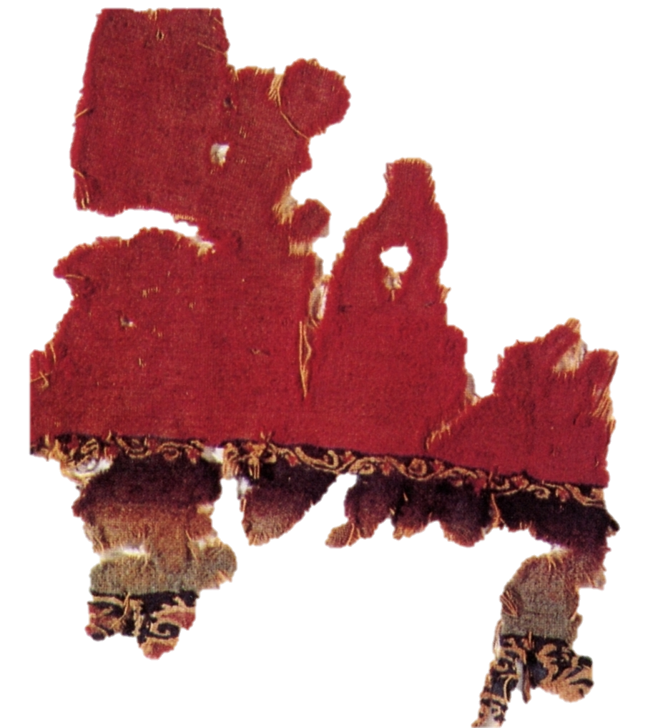
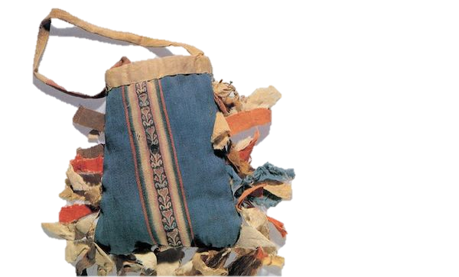
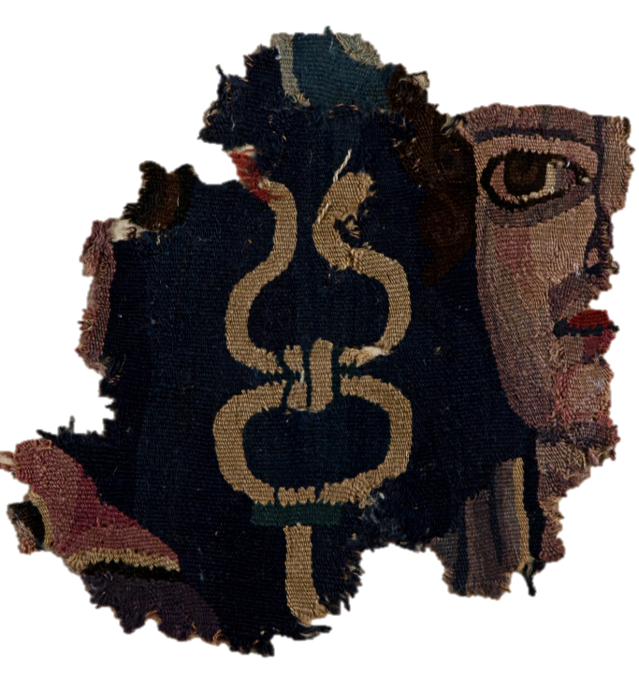
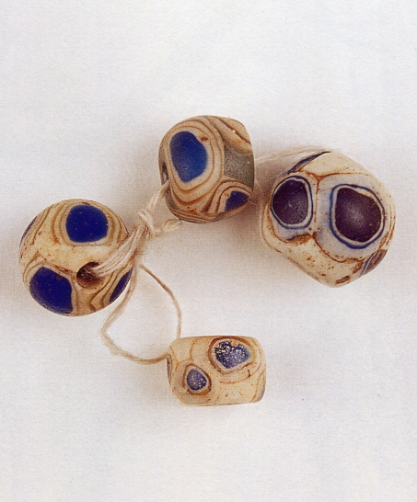
Xinjiang
新 疆楼兰考古队 1988
新疆文物考古研究所 2002
新疆维吾尔自治区博物馆–新疆文物考古研究所 2001.
新疆维吾尔自治区博物馆–新疆文物考古研究所 2001.

Slide 11
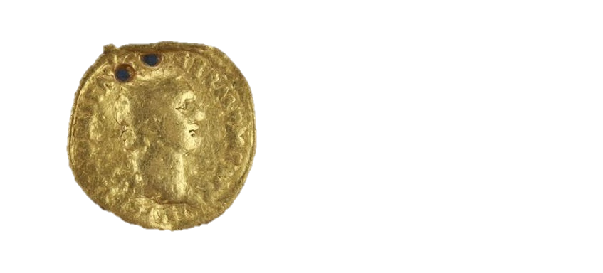
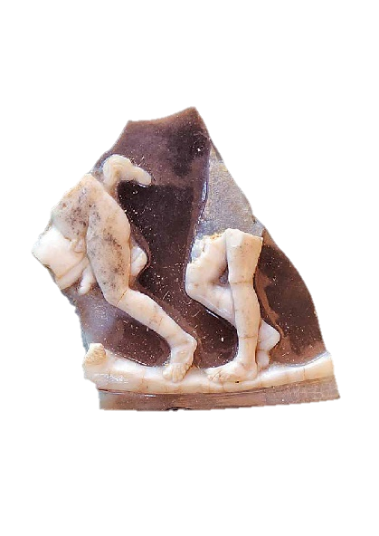
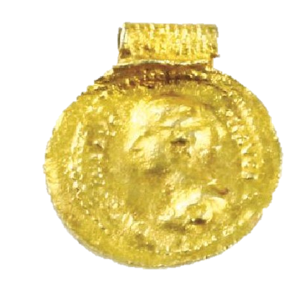
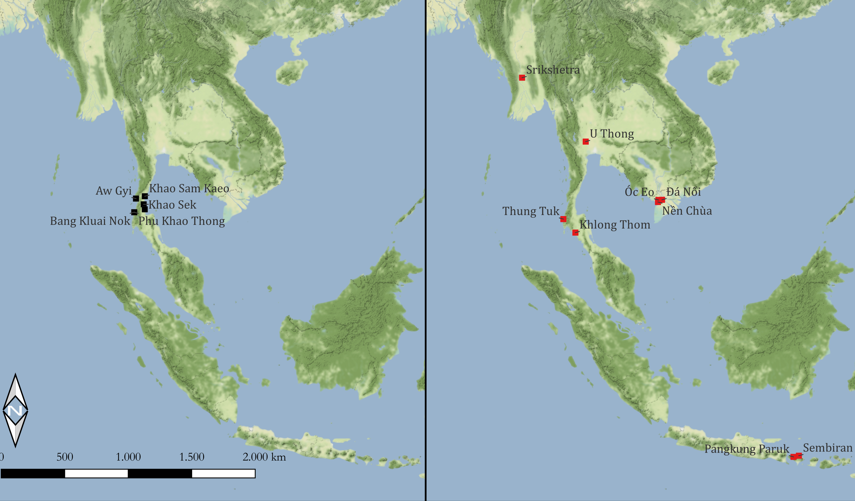
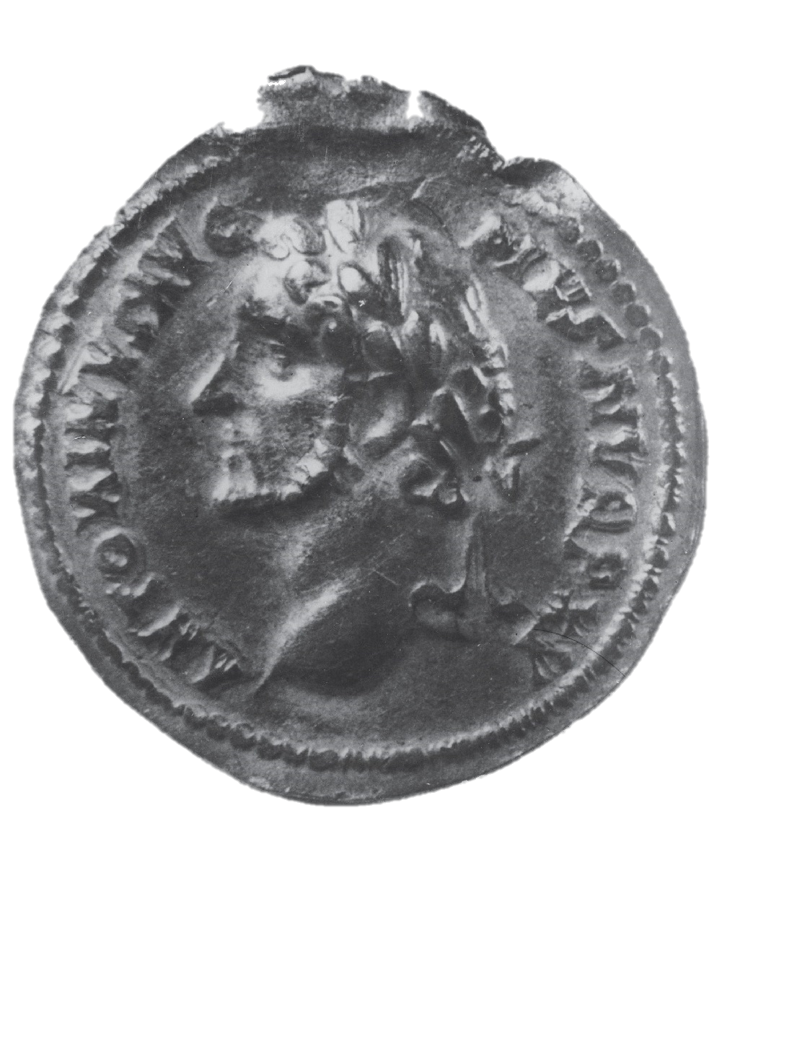
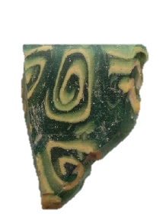
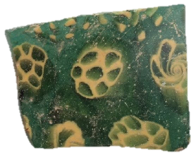
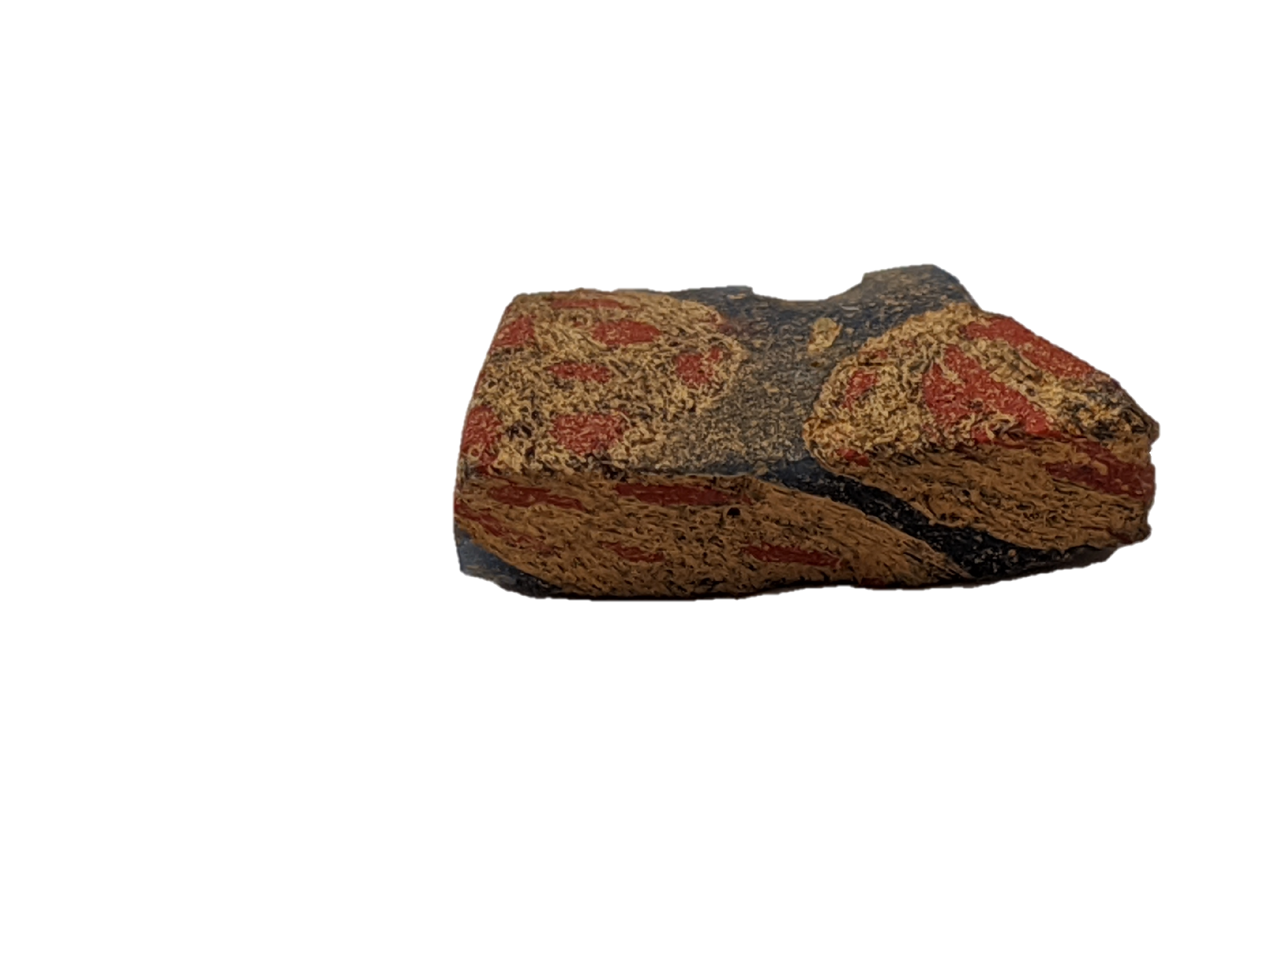
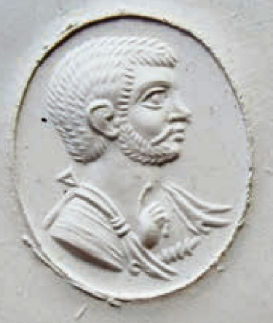
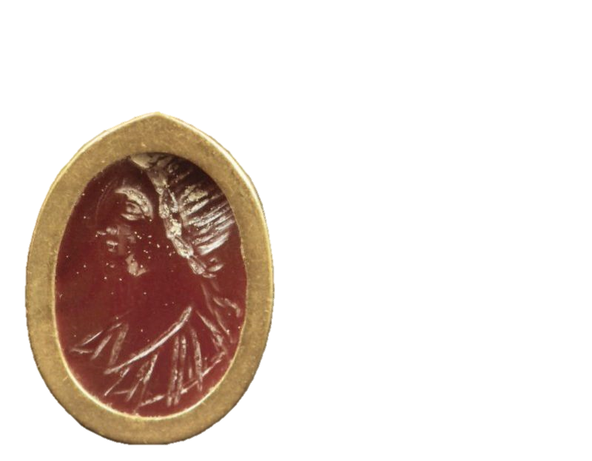
Southeast Asia
Borell 2015; 2019.
Borell 2014.
Borell 2014 et al.
©Dussubieux
Later Sites
Post-First centuries AD
Early sites
Pre-First centuries AD
©Baptiste Pradier

Slide 12
IV. Observations
China
Southeast Asia
Context
Mostly excavated
Without context
Number of sites
23 sites
15 sites
Borell 2019.
Type of sites
Mostly graves
Mostly port-sites
Number of materials
38 entries
73 entries
©Dussubieux
Type of materials
More unified
More diverse
Date of materials
Mostly later
Mostly earlier
Borell 2014.

Slide 13
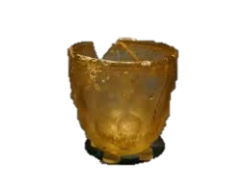
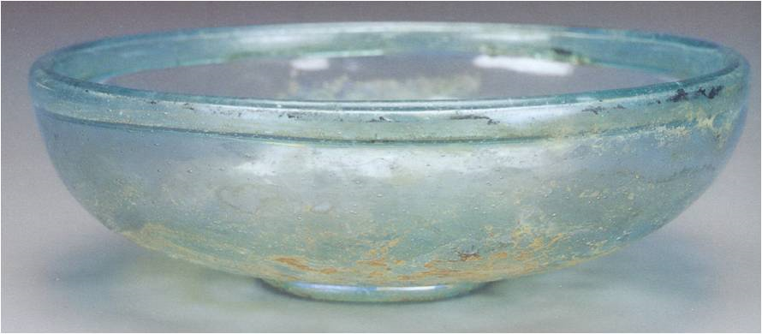
IV. Observations
Eastern China
South China
Xinjiang
Mainland Southeast Asia
Imported
glass beads only
Objects (glass vessels, glass beads, textiles???)
-Objects (glass vessels and coins, engraved gems)
-Raw materials
glass vessels only
1st c. BC – 2nd/3rd c. AD
Gan 2009
Xiong 2014.
1st BC – 3rd c. AD
2nd/3rd – 4th c. AD
Roman Inspired
(coin adaptations,
inspired engraved gems)
mostly later
Nanjingshi Bowuguan 2004.
1st c. AD
gap
4th – 5th/6th c. AD
Roman Inspired
(inspired textiles)
continuously

Slide 14
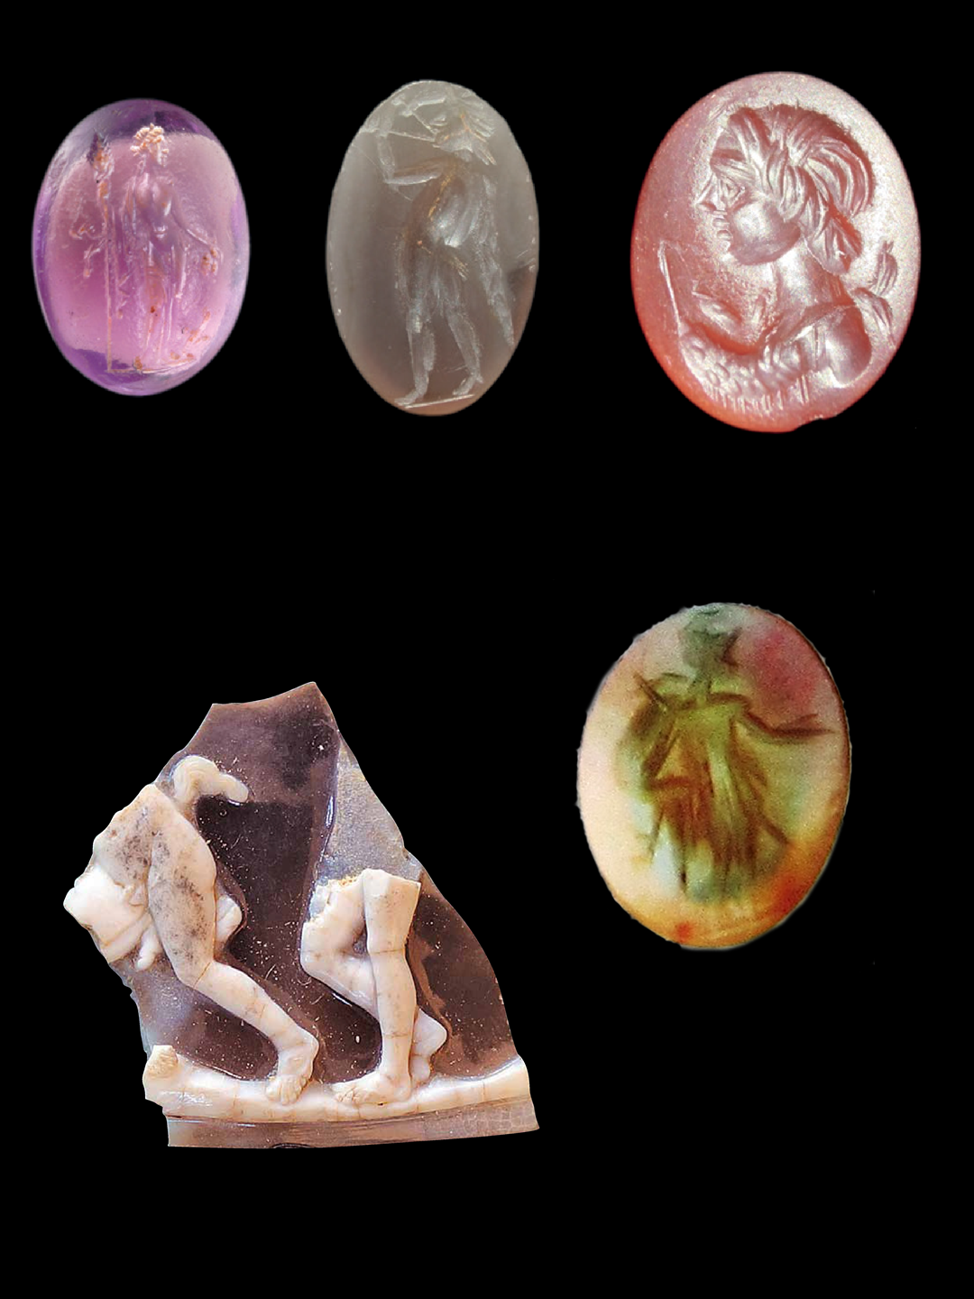
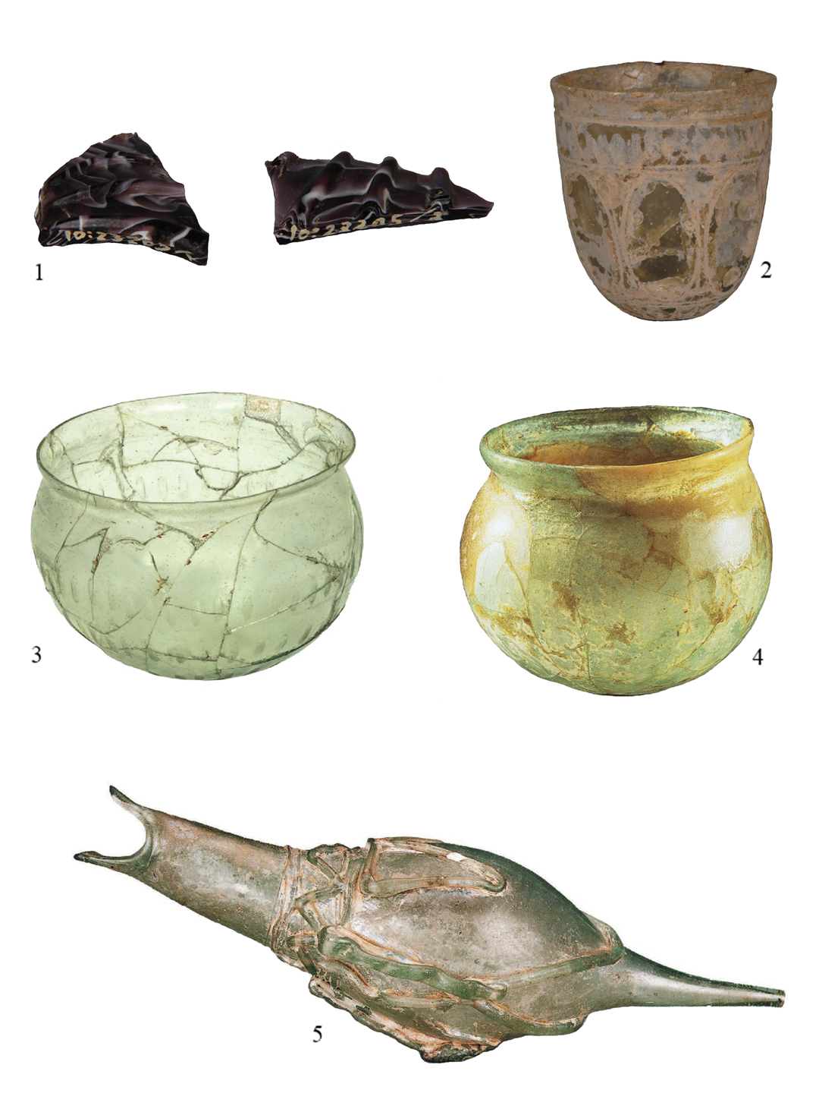
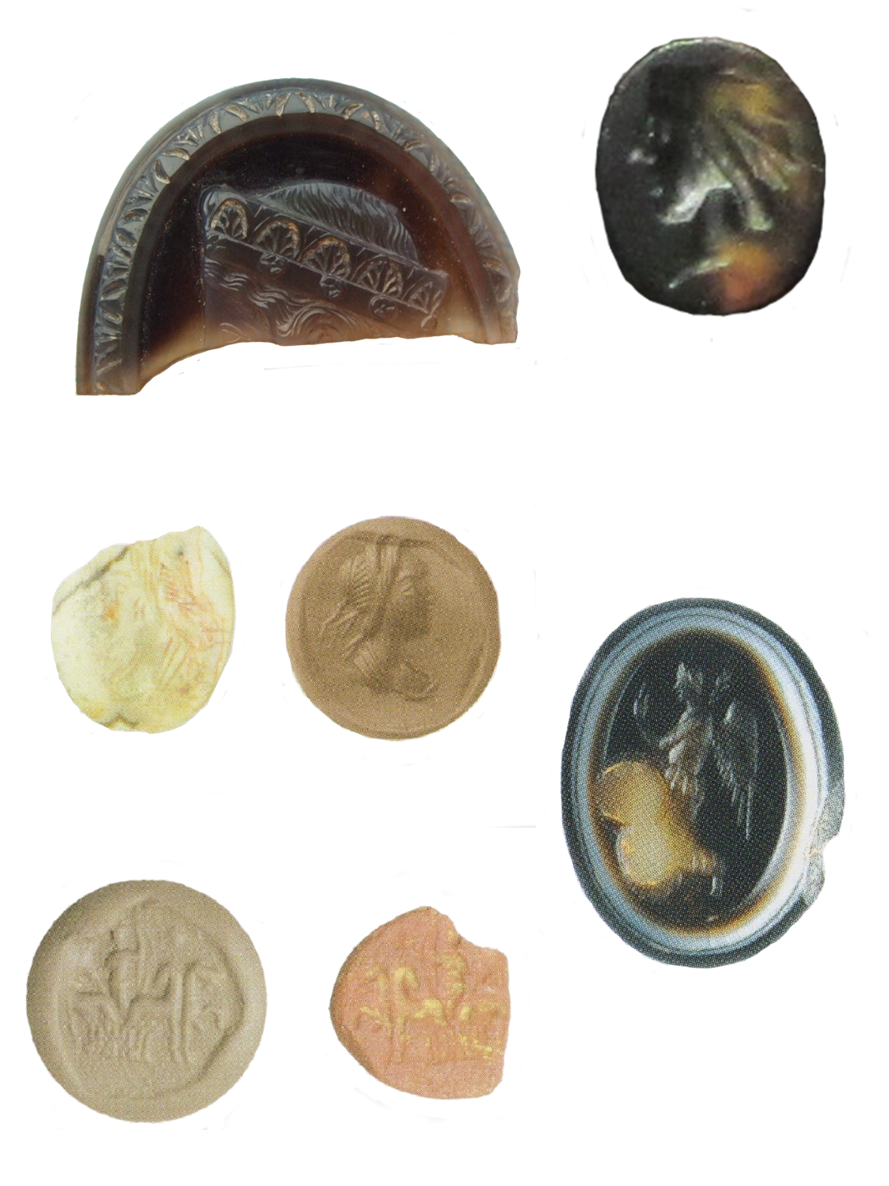
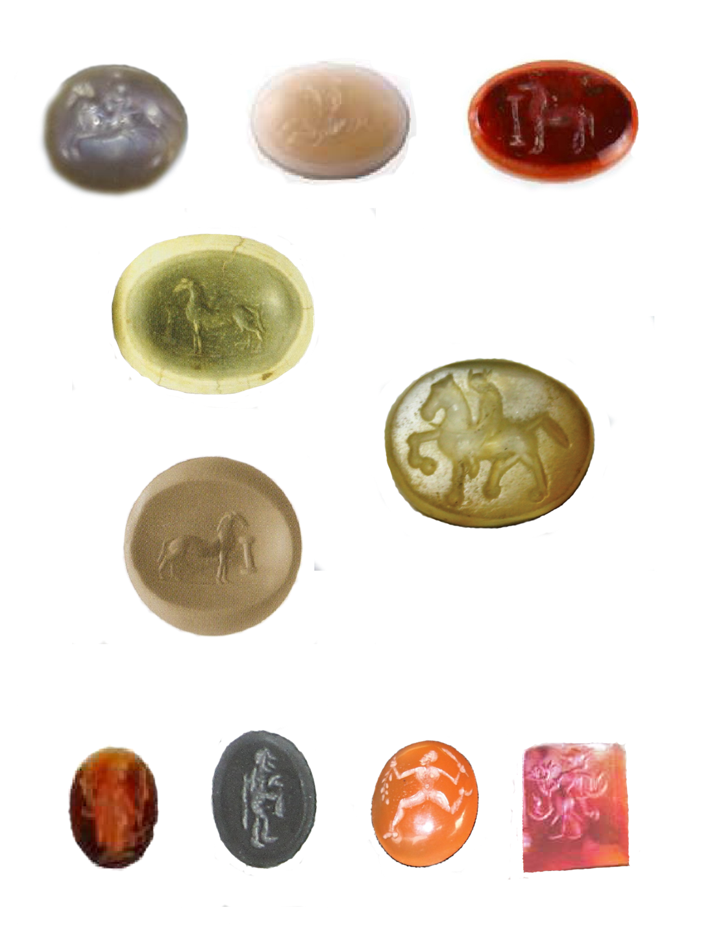
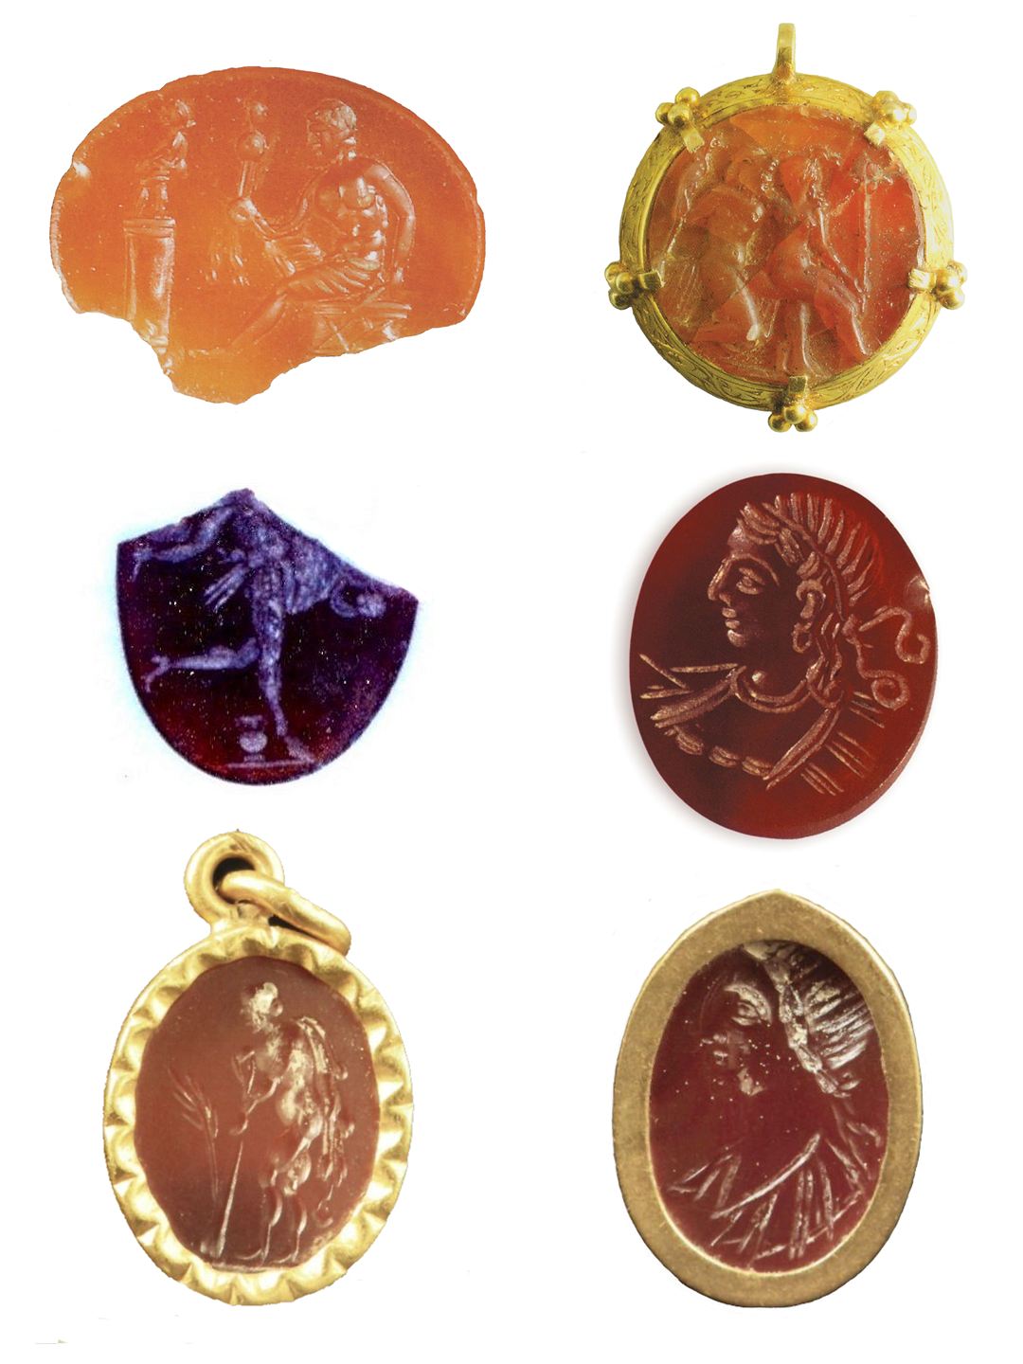
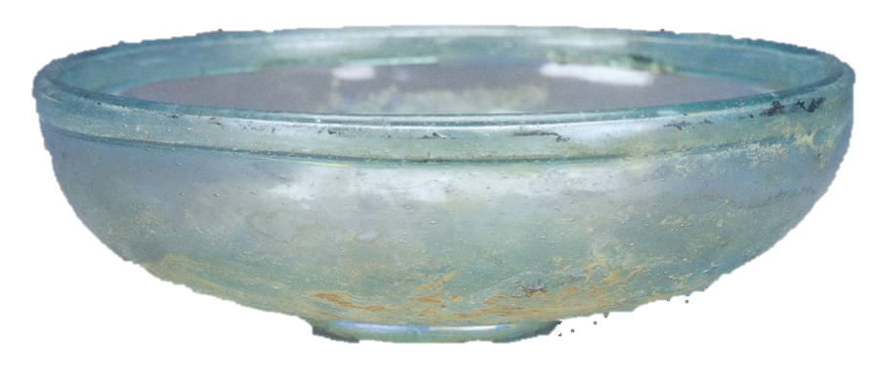
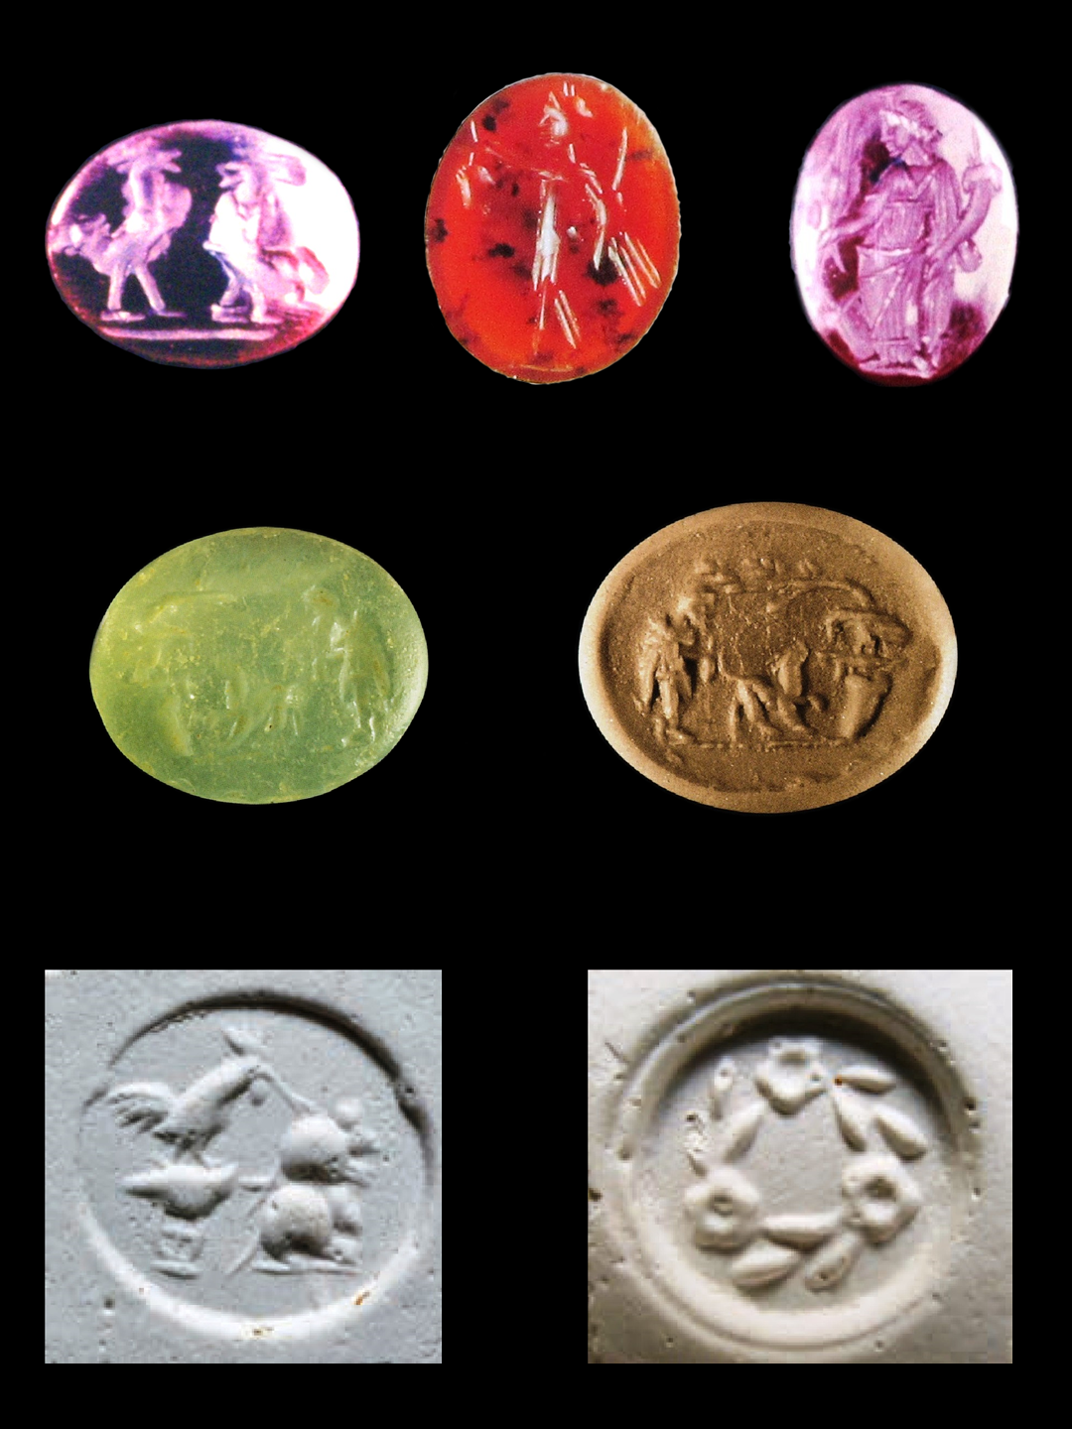
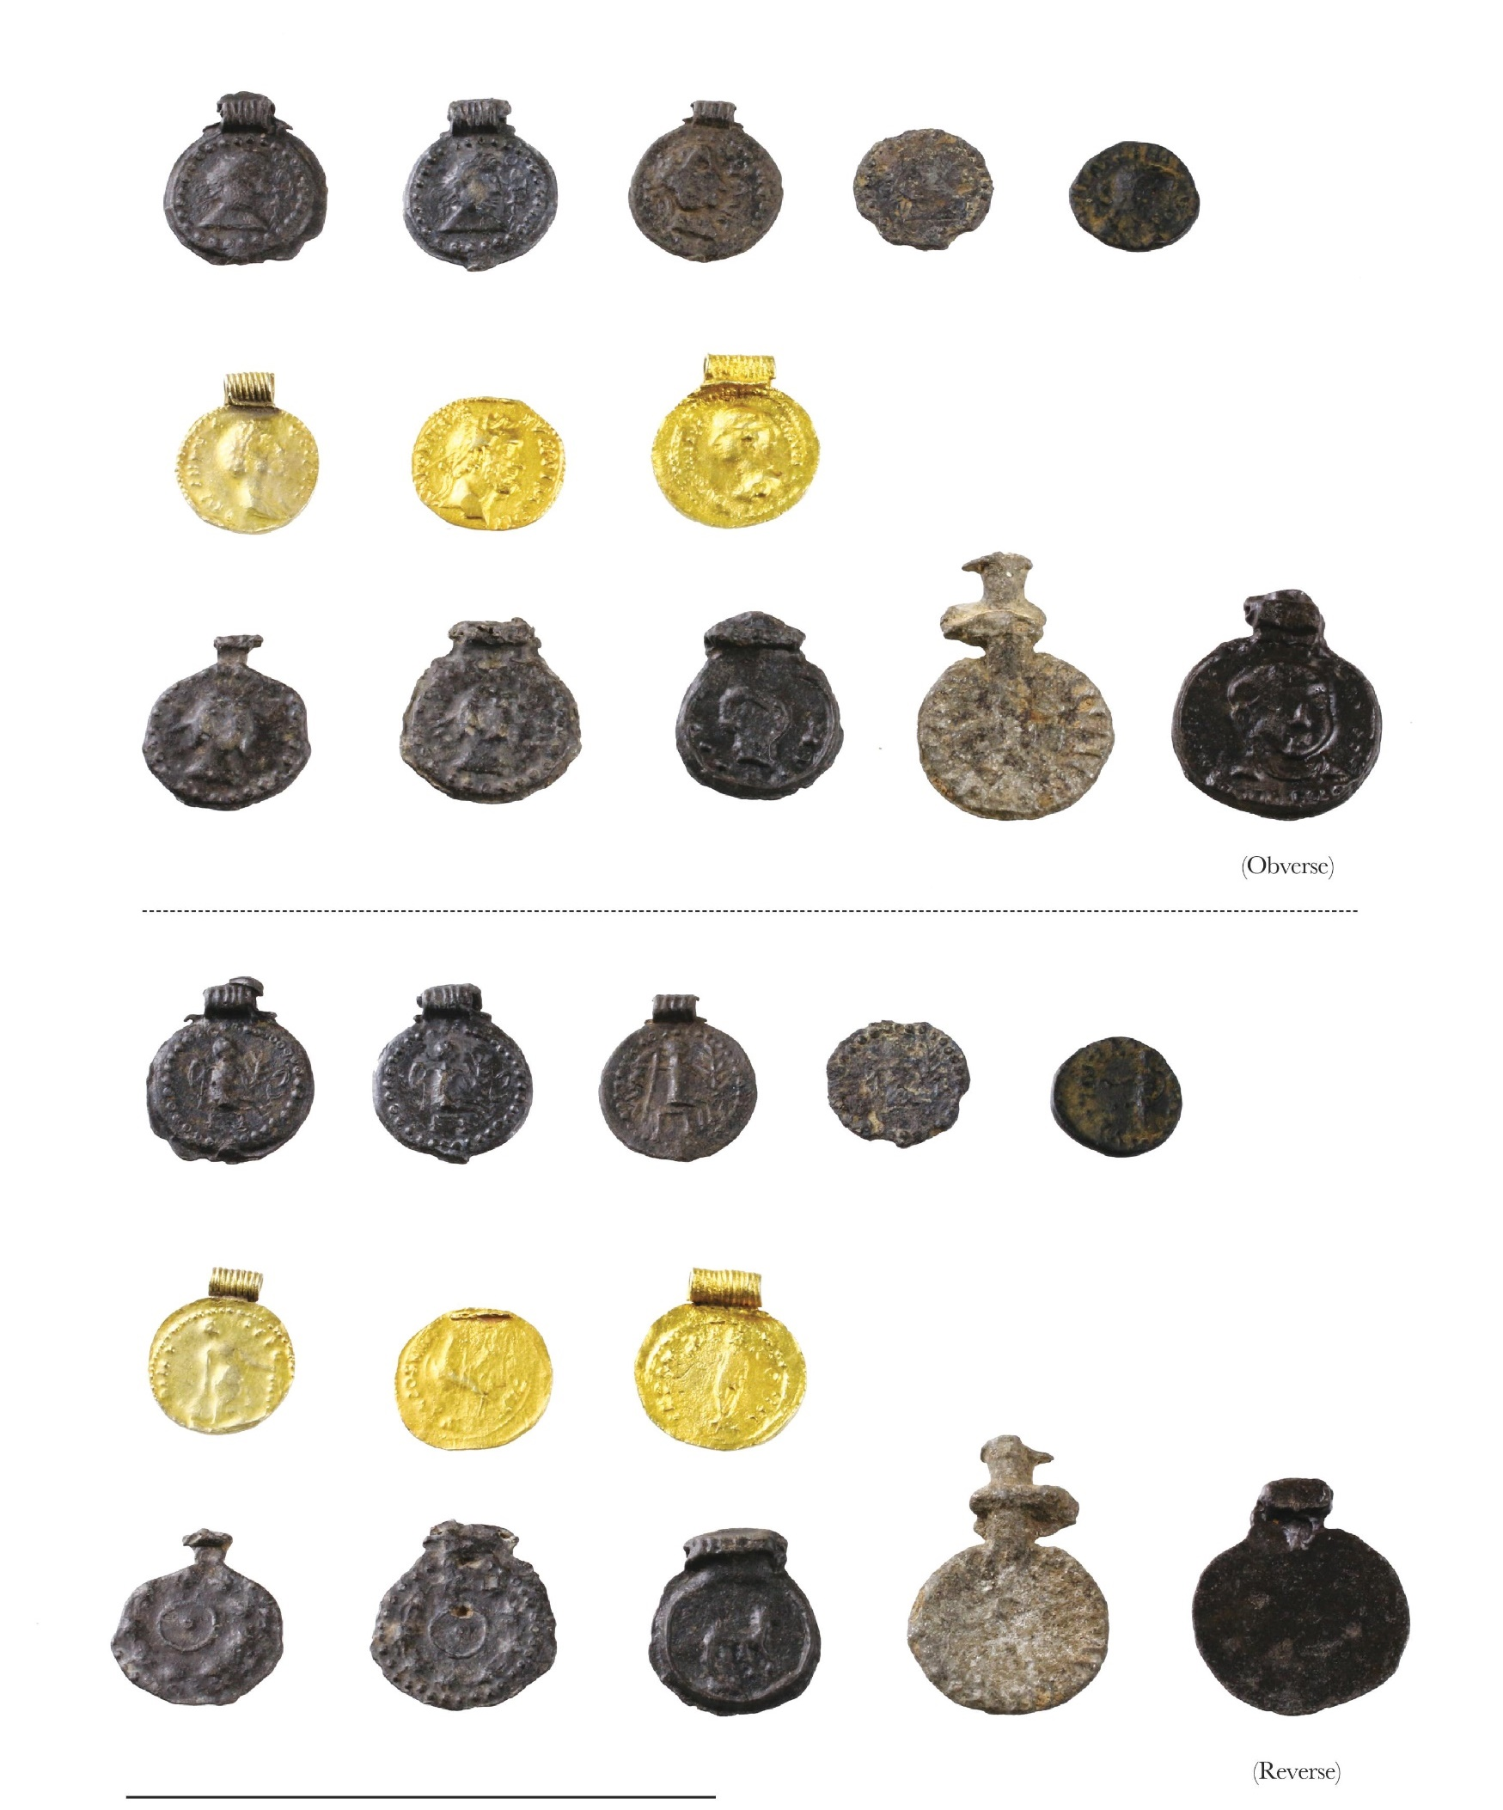
IV. Observations
Regional differences in object preference
Eastern China
Peninsular Thailand & Myanmar
Appreciation for their symbolism
Interpretation & incorporation within local cultural context
Recontextualized
Hoppál 2022.
Borell 2019.

Slide 15
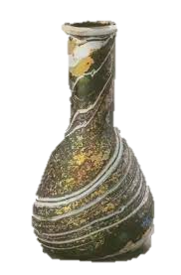
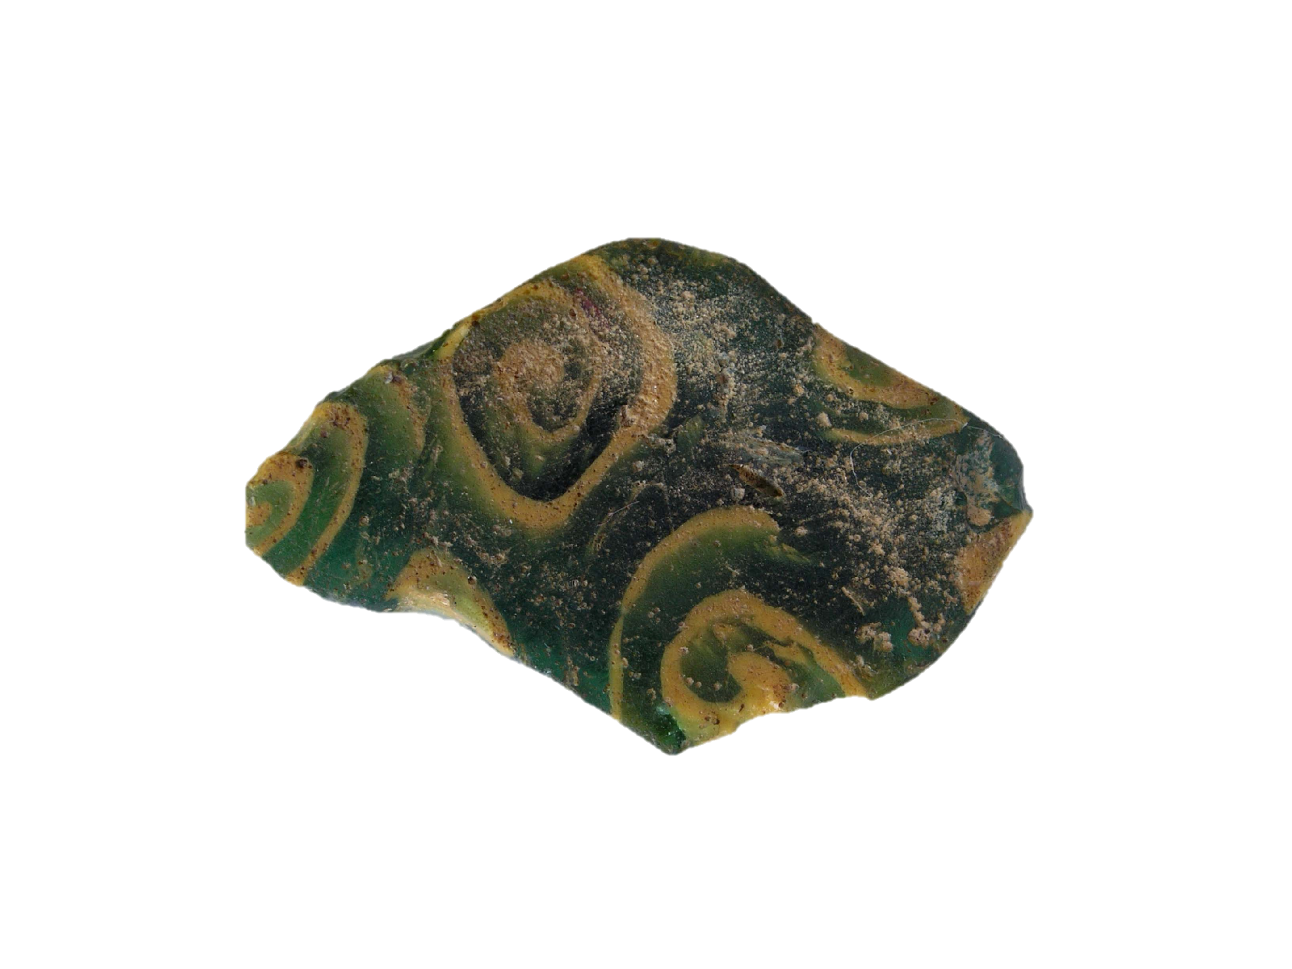
IV. Observations
Links between the early Roman glass vessels found in Eastern China
and the Kra Isthmus
Late 1st c. BC – Early 1st c. AD = Kra Isthmus
1st c. AD = China
Mosaic decoration
Plain vessels
© Nanjing Bowuyuan
Borell 2015&2016.
Luoyangshi wenwu gongzuodui 1990.

Slide 16
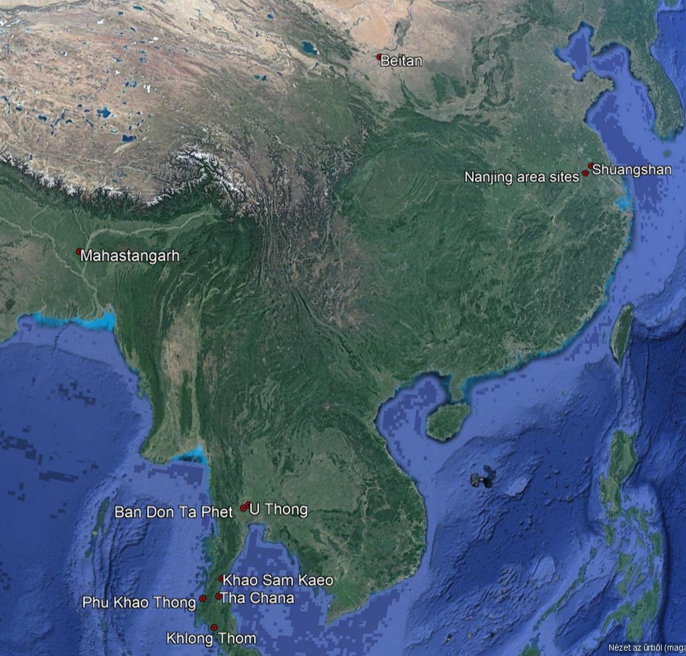
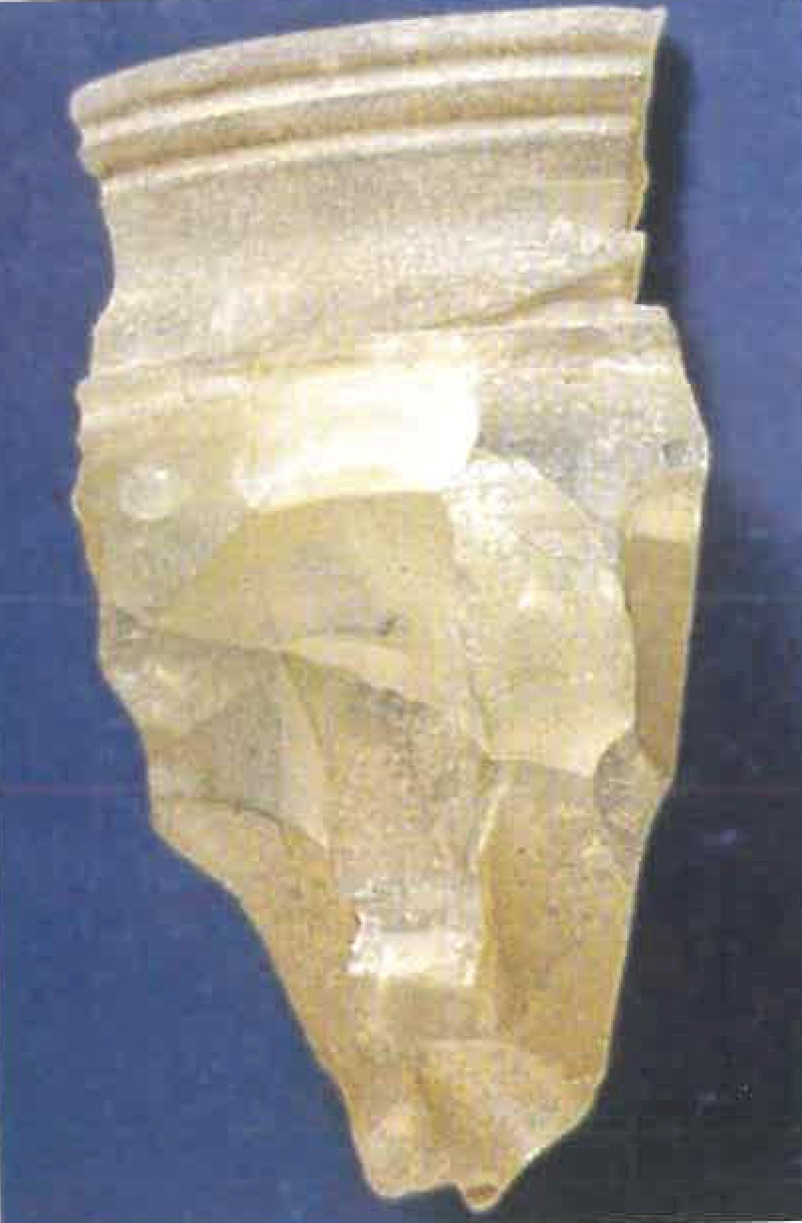
IV. Observations
Routes of Roman objects to East Asia (China)?
1st AD:
1. Maritime routes preferred
=>Via the Kra Isthmus?
2. Maritime&land routes combined
3. Land routes only
=> Sarmatian mediators
4th AD:
In E.China the number of Roman objects increased!!!
Land routes?? => Evidence from Xinjiang
Gonthier et al. 2014.

Slide 17
V. Conclusion
China
Mostly later evidence from the 4th c. AD ( SEA)
More uniformity (except for Xinjiang)
Inspired objects only in Xinjiang
Versus
Further reading:
Hoppál K., B. Bellina, L. Dussubieux 2023. Southeast Asia and the Mediterranean World at the turn of the first millennium CE: networks, commodities and cultural reception. Cambridge Archaeological Journal (in press)

Slide 18
Supported by:
- the ÚNKP-22-5 New National Excellence Program of the Ministry for Innovation and Technology, Hungary and the János Bolyai Research Scholarship of the Hungarian Academy of Sciences.
Thank you!

