Slide 1
On the cultural crossroads. The research activities of the Institute of Ethnology and the 200 years Hungarian Academy of Sciences in connection with Central and East Asia
Szilágyi Zsolt
Institute of Ethnology,
Research Centre for the Humanities, Hungary

Slide 2
The foundation of the HAS
On November 3rd, 1825
Count Széchenyi recommended a whole year’s portion of my income to augment my national language
It was the foundation moment of Hungaryan Academy of Sciences
From the first time Hungarian Academy has always paid attention to support of historical, linguistic and cultural historical researches related to Asia.
From the middle of the 19th Century financially supported researches connected to Asia

Slide 3
Hungarian travellers and researchers in Asia
Hungarian scholars were motivated to study the origins and migrations of the nomadic ancestors of the Hungarians.
From the last decades of the 18th century has led them to a wide range of research areas from the Volga region to Siberia, from the Urals to the Altai, from the Caucasus to China or Mongolia.
Hungarian expeditions started to explore Asia in the 19th century.
This was the period of appearance of Hungarian Turanism.
It was a system of scientific and political views, which constituted an important basis of the interest in the east shown by Hungarians in the late 19th – early 20th centuries.

Slide 4
Bálint Gábor of Szentkatolna
1844-1913
He was a linguist and orientalist.
He researched the Eastern connections of the Hungarian language.
Between 1871 and 1873 supported by the HAS he went on a research trip to Southern Siberia, Central Asia and Mongolia

Slide 5
Ágoston Zichy
1852-1925
He was a lawyer, a traveler, a geographer and a correspondent of the Hungarian Academy of Sciences.
1876 travelled from Beijing to Khüree, the Mongolian capital city.
He wrote about his journey in Geographical Journal and he also published a small booklet on it.

Slide 6
Jenő Zichy (1831-1906)
Jenő Zichy was a lawyer and a landowner.
He led three expeditions to Asia.
1895 – Caucasus
1896 – Caucasus and Central Asia
1897-1898 – Central Asia, Mongolia, China.

Slide 7
Dr. Imre Sebők
1878-1917
He was a Catholic priest and he formerly worked for the Department of Ethnology of the Hungarian National Museum.
In 1913, he travelled in the Asian regions of Russia and in the Mongolian borderland.

Slide 8
György Almásy (1867-1933)
He was the first Hungarian scholar (zoologist and ethnographer), traveler, who visited the Kyrgyz people of the Tianshan Mountains (Ala-tau/too) twice at the beginning of the 20th century (1900 and 1906).
He wrote a 730-page book in Hungarian (My Travel to the Heart of Asia, 1903) about his first trip to the Kyrgyz.
He was the first western scholar outside the Russian Empire to transcribe and translate a short extract from the Kyrgyz epos, Manas.

Slide 9
Activities of Institute of Ethnology related to Eurasia
The Institute of Ethnology of the Research Centre for the Humanities is one of the main institutions is Hungarian ethnography.
Several research programs of the Department of Ethnology are related to Central and Inner Asia and China.
We work on join programs with academic institutions from China, Kazakhstan, Kyrgyzstan, Mongolia, Japan.
An important key objective of the Institute is Tradition and modernization, cultural conditioning and ideologies, religious features, perception of land and environment – field studies and ethnological studies in Siberia and in East-, Inner- and South-East Asia. Most of the programs connected us to the Silk Road, China and Inner Asia.
Our goal now is to share the information collected by us and our predecessors not only with the scientific public but also with the source communities.

Slide 10
Vilmos Diószegi (1923-1972)
He was an internationally recognized Hungarian ethnologist studying Siberian shamanic traditions.
He had the chance to conduct fieldwork in Southern Siberia and the Northern Mongolia four times between 1957 and 1964.
Diószegi influenced the representatives of the local intelligentsia to value their indigenous culture and shamanic traditions and he emphasized the role these in ethnic identity.
Our research group shares his research publications and diaries with the source communities.

Slide 11
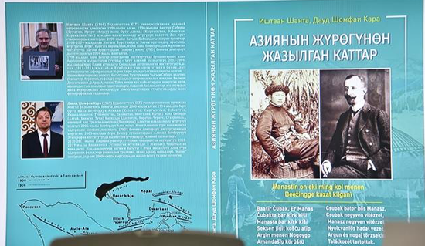
György Almasy’s diaries and research notes translated into local languages, researched, translated and published by István Sántha and Dávid Somfai Kara

Slide 12
Digitalization programs
In accordance with the requirements of the 21st century, we have launched several digitization programs to make our research materials easier to access.
One of the priority research projects of the Institute of Ethnology is the Digitization and preservation of rare historical sources on Inner Asia written in the late Manchu period.
We not only publish the digital contents of individual collections, but we also cooperate with Hungary's largest digital database. It is called Arcanum.
This program is aimed to create a large database from published periodicals, daily papers and lexicons.

Slide 13
Digitalization programs
Arcanum
It is a private initiative.
Today 46 135 450 pages is accessible on Arcanum.
Printed works: journals, periodicals, daily papers, lexicons, books
photos

Slide 15
Buryat hunter

Slide 16
Tsam

Slide 17
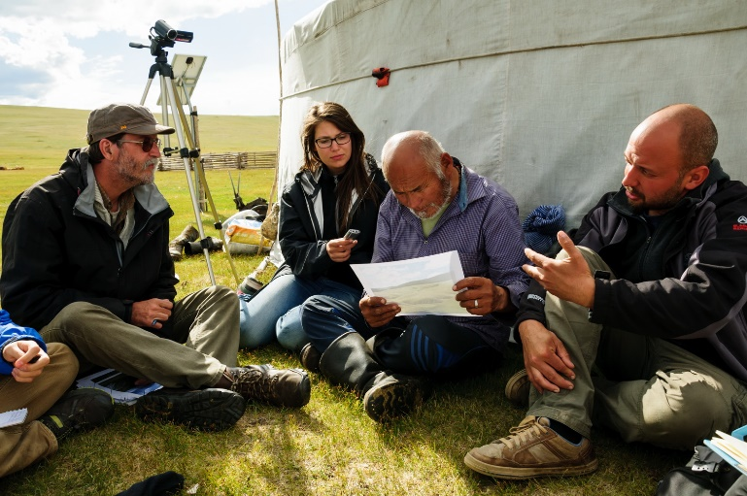
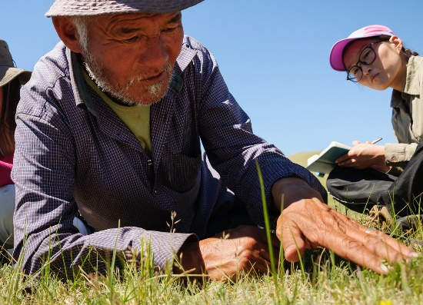
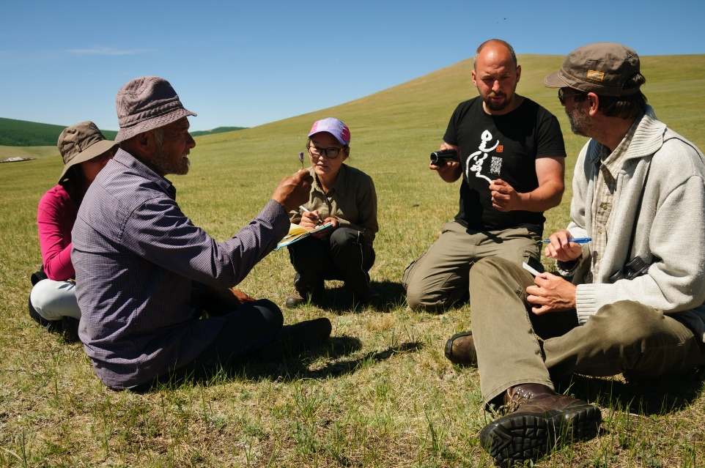
The Etnoecology Research Group of the Institute of Ethnology

Slide 18
Studies on Cultures along the Silk Road
In 2017, the Institute of Ethnography and the Institute Languages of ethnic Literatures launched a joint journal entitled Studies on Cultures along the Silk Road.
The cultural aspects of the Silk Road, the dynamics of the connections between the Far East and Europe, have been placed in other contexts in modern times.
The opportunity to learn from each other, the desire to exchange research experiences and scientific achievements was the impetus behind establishing the journal.

Slide 19
Thank you for your attention!

