Slide 1
ELTE Roman World and the Far East Research Group – Research goals and prospects
Dr. Pap Melinda, PhD.
ELTE University, Institute of East Asian Studies, Hungary
ELTE Roman World and the Far East Research Group member

Slide 2
ELTE Roman World and the Far East Research Group
Set sails in January 2023., with 3 members on board
MISSION:
to highlight the significance of mediator cultures along the ancient Maritime Silk Routes linking the Roman World to the Far East
to question several of the previously held interpretations, such as Rome’s direct involvement in Far Eastern trade networks
METHOD:
comprehensive interdisciplinary research: comparison of the relevant archaeological materials and Chinese textual sources
CHRONOLOGICAL FRAME:
from 200/100BC to 500/600 AD, from the beginning of Rome's Far Eastern interest to the transformation of cross-cultural communications

Slide 4
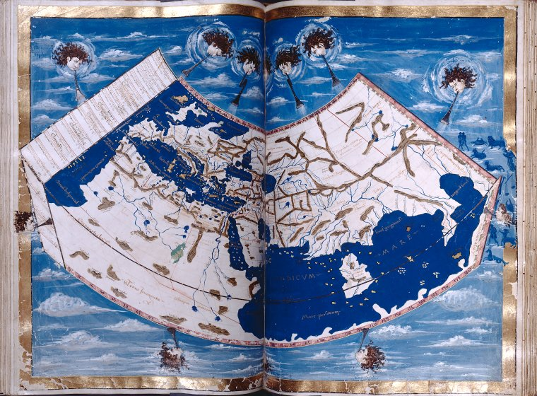
BACKGROUND
studying East–West exchange networks of the early centuries AD is a relatively popular field of research: Roman-centric perspective
significant number of Roman and related artefacts are known, but have not been studied in their complexity, nor complemented by the extensive Chinese written tradition.
studying links between the Roman World and the Far East has been reduced to reconstructing trade in rare and exquisite exotics, disregarding the role of mediator cultures in shaping the nature and degree of these connections

Slide 5
previous Research & results
Dr. Hoppál Krisztina Kinga:
collected and analyzed the most significant Chinese- and Roman-interpreted archaeological finds, and incorporated these archaeological remains into the complex written tradition of the two empires
started to build a database of Roman objects discovered in Southeast Asia
collected, analyzed and compared the Thailand- and China-found Roman materials: demonstrated that certain dissimilarities are existing regarding their types, distribution and date, suggesting differences in networks, routes and time periods of transferring these objects
attempted to identify the connection between the Imperium-originated and the potentially locally-regionally made ‘hybridized’ products
→ these new results created a strong need to re-consider some of the widely accepted interpretations, and to re-evaluate the written records, particularly Chinese texts
→ literature outside the dynastic historiographies should be included (such as geographical treaties, encyclopedias, etc.) – these provide ample descriptions of both Southeast Asia and the Far West, giving unique insights into Chinese perceptions of the outer world
→ focus on regions not yet covered in detail, such as Vietnam and South China

Slide 6
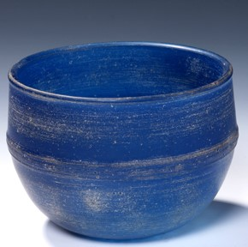
Specific aims & methods
our goal is to develop an understanding regarding the relations between the Roman World, Southeast Asia and China
to provide a comprehensive and synthetized study including written texts, a complex database of archaeological data (both Roman and related materials), and a theoretic framework.
we intend to shed new light on the different networks and communities operating along the Maritime Silk Routes through looking into the following questions:
1. How could we define the exact nature of links between the Roman World and the Far East?
2. What do these evidences of Roman era exchanges between the West and the East found along the Maritime Silk Routes tell us about regional interactions?
3. What can we infer about the role of South China Sea communities in cross-regional networks based on the archaeological and textual data?
4. How do these evidences relate to our existing knowledge on early global interconnectivity?

Slide 7
A. Vietnam between the Roman World and China
Óc Eo (at the Mekong Delta) has long been recognized as a powerful regional center, linked with the history of the kingdom of Funan
recent excavations uncovered an enormous amount of new evidence
analyzing the new data and placing the information into the context of written materials can provide a new and more comprehensive understanding of Óc Eo culture and its position between the Roman World and China
AIMS:
to examine and to re-evaluate new and old data by studying sites on the south coastal area of Vietnam, and to reveal more about the context of Roman and related objects
to re-analyze Chinese accounts on Funan and its inhabitants, with special attention to non-dynastic histories, such as Kang Tai’s Waiguozhuan or the Funan yiwuzhi
to unveil the Chinese perceptions on this polity and its economic and cultural exchanges, and to uncover how these relate to the newly discovered archaeological materials
to better comprehend the role of Vietnam in transferring Roman objects to the Far East

Slide 8
b. Lingnan and the Roman World
The Lingnan area (covered regions of present-day South China and northern Vietnam):
had a significant position in ancient maritime interactions,
yielded several non-local objects including beads of Mediterranean composition, as well as a potentially locally developed glass industry producing glass vessels found as far as South Asia
the relation of local communities to this local glass industry, and their potential involvement in maritime networks is still unknown
AIMS:
to study Chinese texts potentially referring to various types of glass materials (such as liuli, boli or shuijing) in order to shed light on the different levels and evolution of the Chinese perceptions of glass.
to reflect on the recently re-emerged scholarly debates regarding the source of inspiration for these locally made glass vessels
to compare the social context of the locally made vessels with the ones of the Roman glass vessels found in China, as well as with the South China-discovered glass beads of Mediterranean composition
to better comprehend the economic, political and cultural actors behind the development of local glass production, and to reveal more about the possible role of local communities in ancient maritime networks

Slide 9
c. Comparing western and eastern perceptions on Southeast Asia
Substantial amount of debate exists on the relevance of written texts, which refer to Southeast Asia during the early first centuries.
These accounts generated in the Far West and the Far East have never been studied in their complexity, nor have been compared with the archaeological reality.
AIMS:
to collect and analyze these records (particularly Ptolemy, Pliny and Chinese works referring to Lingnan, Funan and other Southeast Asian regions) in a critical way, and to reveal how these accounts relate to the Chinese records on the Far West and the western descriptions of the Far East?
through working with original texts (Latin, ancient Greek and Chinese), we hope to see beyond the existing translations

Slide 10
D. Building a theoretical framework for understanding local reception/use of Roman and related materials
Roman objects discovered in China and Southeast Asia have often been merely used for reconstructing systems of exchange or chronology, reducing them to their properties as being foreign.
Focusing on the ways in which non-local objects were used and contextualized can enrich our understanding of the social life of these artefacts.
AIMS:
to use theoretical models in order to better comprehend why certain communities with different cultural backgrounds preferred different types of Roman and related objects in Southeast Asia and China?
we intend to include relevant aspects of human-things entanglement, the process of cultural appropriation, consumption history, and reception theory through intensive library research and discussions with scholars working in this field

Slide 11
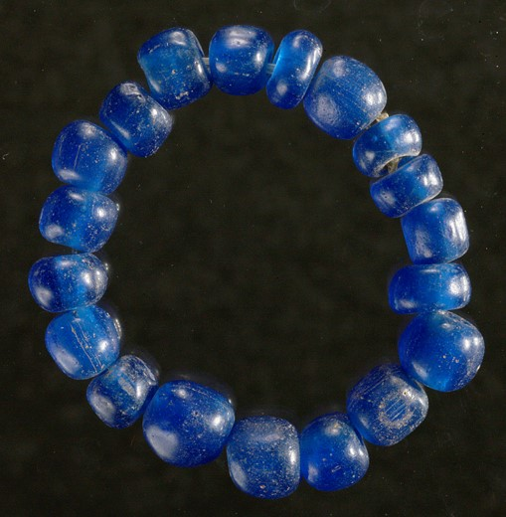
Wider horizons
to draw attention to the complexity of ancient communication networks operating along the Silk Roads and to stress the significance of mediator cultures.
to show the entanglement between terrestrial and maritime routes used in cross-cultural communications in antiquity
at the end of the three-years research period we intend to place our results into a wider context by organizing an international conference on early global interconnectivity
our broader aim would be to expand the project both in terms of spatial and temporal aspects, and to study cultural exchanges and interactions across the land and maritime trans-Asiatic routes between the last centuries BC and early first centuries AD
Welcome to visit our homepage at:: https://romanworld.konfuciuszintezet.hu hoppal.krisztina@konfuciusz.elte.hu pap.melinda@btk.elte.hu

Slide 12
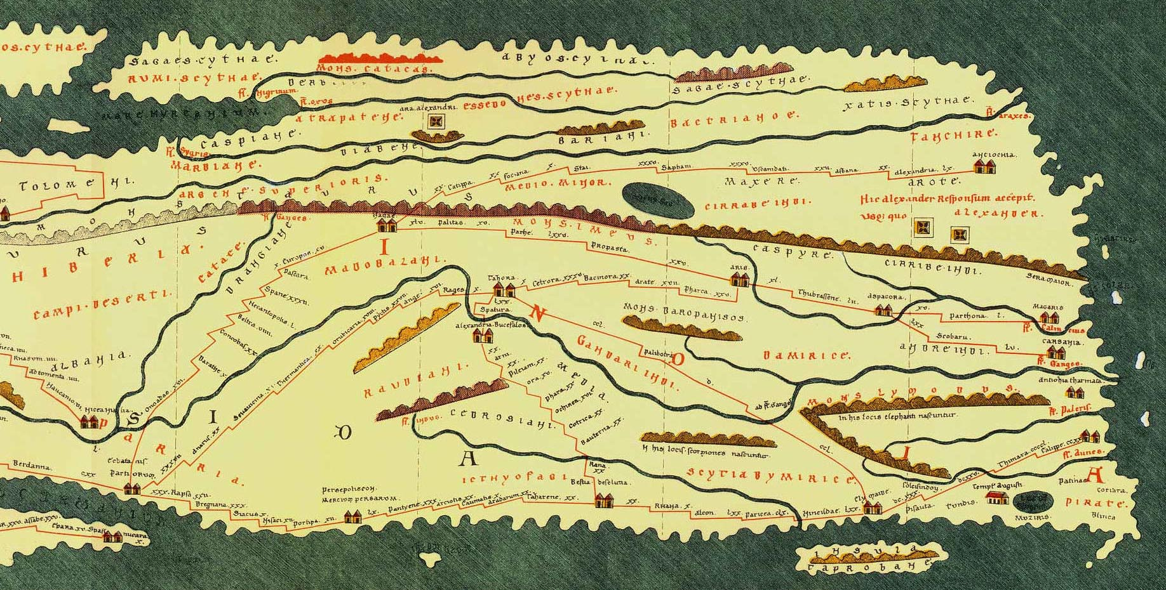
Thank you for your attention! 谢谢！

